Slide 2
ANSIBLE
AUTOMATION FOR EVERYONE
V6
12/05/2025

Slide 3
Day 1 :
  Introduction
  What is Ansible
  How does it Work
  Commande line
  Inventory
  Playbooks
  Modules
    Lunch Break
  Variables
  Errors
  Delegation
Day 2 :
  Filters
  Conditions
  Loops
  Tags
  Lunch Break
  Templates JINJA2
  Asynch
  Vault
Day 3 :
  Roles and Galaxy
  Strategies
  Extend Ansible
  Write a Module
  Lunch Break
  Real Use Case
  Best Practices
  Automation Integration

Slide 4
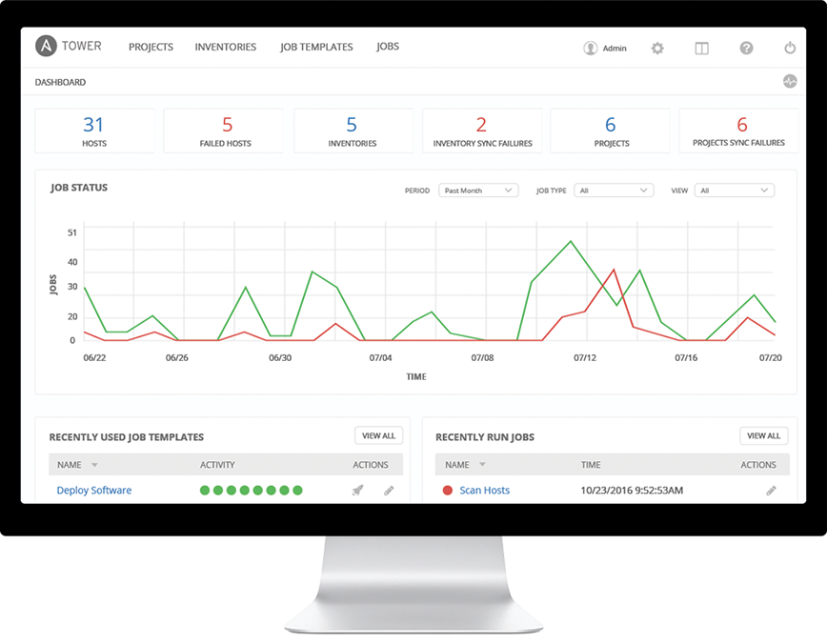
It’s a simple automation language that
can perfectly describe an IT application infrastructure in Ansible Playbooks.
It’s an automation engine that runs
Ansible Playbooks.
Ansible automation controller (Red Hat Ansible Automation Platform) and its upstream project AWX are
frameworks for controlling, securing
and managing your Ansible
automation with a UI and restful API.
capture historique (ancienne interface)

Slide 5
USE CASES
CONFIG MANAGEMENT
Centralizing configuration file management and deployment is a common use case for Ansible, and it’s how many power users are first introduced to the Ansible automation platform.
APP DEPLOYMENT
When you define your application with Ansible, and manage the deployment with automation controller / AWX, teams are able to effectively manage the entire application lifecycle from development to production.
PROVISIONING
Your apps have to live somewhere. If you’re PXE booting and kickstarting bare-metal servers or VMs, or creating virtual or cloud instances from templates, Ansible and automation controller / AWX help streamline the process.
CONTINUOUS DELIVERY
Creating a CI/CD pipeline requires buy-in from numerous teams. You can’t do it without a simple automation platform that everyone in your organization can use. Ansible Playbooks keep your applications properly deployed (and managed) throughout their entire lifecycle.
SECURITY & COMPLIANCE
When you define your security policy in Ansible, scanning and remediation of site-wide security policy can be integrated into other automated processes and instead of being an afterthought, it’ll be integral in everything that is deployed.
ORCHESTRATION
Configurations alone don’t define your environment. You need to define how multiple configurations interact and ensure the disparate pieces can be managed as a whole. Out of complexity and chaos, Ansible brings order.

Slide 6
SIMPLE
POWERFUL
POWERFUL
AGENTLESS
AGENTLESS
Human readable automation
No special coding skills needed
Tasks executed in order
Get productive quickly
App deployment
Configuration management
Workflow orchestration
Orchestrate the app lifecycle
Agentless architecture
Uses OpenSSH, WinRM & PSRP
No agents to exploit or update
More efficient & more secure

Slide 7
DATA IS WRITTEN IN YAML
Tasks are executed sequentially
Invokes Ansible modules
Idempotency
Multi OS, Agentless
Red Hat Enterprise Linux
AIX
Sun
Windows….
Not only servers:
Network Appliance Big IP F5, OpenVSwitch, Citrix, Cisco…
Assets (storage, supervision, ...)

Slide 8
HOW ANSIBLE WORKS
Inventory:
Describe the servers/objects organization
Can be dynamically extracted
CLOUD:
OpenStack, VMware, EC2, Rackspace, GCE,
Azure, Spacewalk, Hanlon, Cobbler
CUSTOM CMDB
CMDB
PUBLIC / PRIVATE
CLOUD
ansible-core
ANSIBLE-CORE (AUTOMATION ENGINE)
USERS
INVENTORY
API
HOSTS
INVENTORY
API
MODULES
PLUGINS
MODULES
PLUGINS
NETWORKING
ANSIBLE PLAYBOOK

Slide 9
HOW ANSIBLE WORKS
MODULES ARE “TOOLS IN THE TOOLKIT”
CMDB
Python, Powershell, or any language
Extend Ansible simplicity to entire stack
PUBLIC / PRIVATE
CLOUD
ansible-core
ANSIBLE-CORE (AUTOMATION ENGINE)
USERS
INVENTORY
API
HOSTS
INVENTORY
API
MODULES
PLUGINS
MODULES
PLUGINS
NETWORKING
ANSIBLE PLAYBOOK

Slide 10
ansible-core
ansible-core
Plugins
Hosts
Modules
Result
Playbook
Task
Task
Task
Task
Users
Inventory
Networking
CMDB
Servers Reference

Slide 11
# yum install ansible
# apt install ansible
$ ansible -i <Inventaire> all -m <module> [-e extra vars] [-a MODULES-ARGS]
$ ansible 127.0.0.1, all -m ping
[WARNING]: provided hosts list is empty, only localhost is available. Note that the implicit localhost does not match 'all'
127.0.0.1 | SUCCESS => {
"changed": false,
"ping": "pong"
}

Slide 12
Command Line
$ ansible-playbook -i <inventaire> [-l <hosts…>] [-e extravars …] <playbook>
$ ansible-playbook -i 127.0.0.1, ping.yaml
PLAY [127.0.0.1] ***************************************************************
PLAY [all] *********************************************************************
TASK [Gathering Facts] *********************************************************
ok: [127.0.0.1]
TASK [PING] ********************************************************************
ok: [127.0.0.1]
TASK [resultat] ****************************************************************
ok: [127.0.0.1] => {
"msg": {
"changed": false,
"failed": false,
"ping": "pong"
}
}
PLAY RECAP *********************************************************************
127.0.0.1 : ok=3 changed=0 unreachable=0 failed=0
Notes:
12
- hosts: 127.0.0.1
gather_facts: no
connection: local
tasks:
- hosts: all
tasks:
- name: PING
ping:
register: result
- name: resultat
debug:
msg: "{{ result }}"

Slide 13
Inventory
https://docs.ansible.com/ansible/latest/user_guide/intro_inventory.html
Notes:
The real work. General format:
<<module>>: key=value
13

Slide 14
What is an Inventory?
Definition:
The list of managed nodes (or hosts) that Ansible configures.
Formats:
Various formats, with INI and YAML.
Default Location:
The default inventory file is located at /etc/ansible/hosts.
Groups:
Hosts can be organized into groups to simplify management and task execution.
Dynamic Inventory:
Plugins to generate inventories from external sources

Slide 15
Inventory EXAMPLE : FLAT
[WEB]
SRV1-1
SRV1-2
SRV2-1
SRV2-2
[DB]
SRV1-11
SRV1-12
SRV2-11
SRV2-12
[APP1]
SRV1-1
SRV1-2
SRV1-11
SRV1-12
[APP2]
SRV1-1
SRV1-2
SRV1-11
SRV1-12
...
Projet1
WEB
APP 1
APP2
SRV1-1
SRV1-2
SRV2-1
SRV2-2
DB
SRV1-11
SRV1-12
SRV2-11
SRV2-12

Slide 16
Inventory EXAMPLE : Tree
[APP1-web]
SRV1-1
SRV1-2
[APP1-db]
SRV1-3
SRV1-4
[APP2-web]
SRV2-[1:2]
[APP2-db]
SRV2-[11:12]
Projet1
WEB
APP 1
APP2
SRV1-1
SRV1-2
SRV2-1
SRV2-2
[APP1:children]
APP1-web
APP1-db
[APP2:children]
APP2-web
APP2-db
DB
SRV1-11
SRV1-12
SRV2-11
SRV2-12
[WEB:children]
APP1-web
APP2-web
[DB:children]
APP1-db
APP2-db

Slide 17
Format INI:
History
  Created in the early 1980s
  Initially used by MS-DOS and Windows
  Name comes from "initialization"
  Widely used for simple configuration files
Advantages
  Simple and easy to read
  Human-friendly format
  Minimal learning curve
  Good for basic configurations
  Supported by many programming languages
Disadvantages
  Limited structure (only two levels of hierarchy)
  No standardization
  No support for complex data types
  Inconsistent implementations
  Limited array support
Notes:
! Les groups APP1 et 2 sont a changer de groupe

Slide 18
Format INI:
Example
  [database]
  host=localhost
  port=5432
  name=mydb
  [server]
  ip=192.168.1.1
  max_connections=100
Notes:
! Les groups APP1 et 2 sont a changer de groupe

Slide 19
Format JSON:
History
  Created by Douglas Crockford in 2001
  Subset of JavaScript object notation
  Became RFC standard in 2006
  Now the de facto standard for web APIs
Advantages
  Language-independent
  Easy to parse and generate
  Strict and predictable syntax
  Excellent programming language support
  Perfect for data interchange
  Fast parsing speed
Disadvantages
  No comments support
  More verbose than YAML
  Less human-readable for complex structures
  Strict syntax (trailing commas not allowed)
  No support for data references
  Limited data types
Notes:
! Les groups APP1 et 2 sont a changer de groupe

Slide 20
Format JSON:
Example
  {
  "database": {
  "host": "localhost",
  "port": 5432,
  "name": "mydb",
  "users": [
  {
  "name": "admin",
  "rights": ["read", "write"]
  },
  {
  "name": "guest",
  "rights": ["read"]
  }
  ]
  }
  }
Notes:
! Les groups APP1 et 2 sont a changer de groupe

Slide 21
Format YAML:
History
  Created in 2001
  Name: "YAML Ain't Markup Language"
  Designed to be human-readable
  Initially popular in Ruby community
  Widely adopted by DevOps tools (Ansible, Docker, Kubernetes)
Advantages
  Very readable and clean syntax
  Supports complex data structures
  Allows comments
  Supports references and anchors
  Perfect for configuration files
  Rich data types support
Disadvantages
  Indentation-sensitive (can be error-prone)
  Multiple ways to write the same thing
  Can be complex for advanced features
  Parsing can be slower than JSON
  Whitespace rules can be confusing
Notes:
! Les groups APP1 et 2 sont a changer de groupe

Slide 22
Format YAML:
Example
  database:
  host: localhost
  port: 5432
  name: mydb
  users:
  - name: admin
  rights: [read, write]
  - name: guest
  rights: [read]
Notes:
! Les groups APP1 et 2 sont a changer de groupe

Slide 23
Format Comparison Table:
Feature | INI | YAML | JSON
Readability | High | High | Medium
Complexity | Low | High | Medium
Hierarchy Support | Limited | Full | Full
Comments Support | Yes | Yes | No
Learning Curve | Low | Medium | Low
Parsing Speed | Fast | Slow | Fast
Data Types | Basic | Rich | Basic
Standardization | No | Yes | Yes
Notes:
! Les groups APP1 et 2 sont a changer de groupe

Slide 24
Format Use Cases:
INI
  Simple application configs
  User preferences
  Basic settings files
  Windows system configs
YAML
  Ansible playbooks
  Docker compose files
  Kubernetes manifests
  Complex configurations
  CI/CD pipelines
JSON
  API responses
  Web services
  Data interchange
  Cross-platform configs
  Database exports
Notes:
! Les groups APP1 et 2 sont a changer de groupe

Slide 25
Format INI:
[all]
[APP1:children]
WEB
DB
[APP2:children]
WEB
DB
[WEB]
srv1-1 ansible_host=192.168.1.101 ansible_user=root
srv1-2 ansible_host=192.168.1.102 ansible_user=root
srv2-1 ansible_host=192.168.1.201 ansible_user=root
srv2-2 ansible_host=192.168.1.202 ansible_user=root
[DB]
srv1-11 ansible_host=192.168.1.111 ansible_user=root
srv1-12 ansible_host=192.168.1.112 ansible_user=root
srv2-11 ansible_host=192.168.1.211 ansible_user=root
srv2-12 ansible_host=192.168.1.212 ansible_user=root
Notes:
! Les groups APP1 et 2 sont a changer de groupe

Slide 26
Format JSON:
{"_meta": { "hostvars": {
"srv1-1": { "ansible_host": "192.168.1.101", "ansible_user": "root" },
"srv1-2": { "ansible_host": "192.168.1.102", "ansible_user": "root" },
"srv1-11": { "ansible_host": "192.168.1.111", "ansible_user": "root" },
"srv1-12": { "ansible_host": "192.168.1.112", "ansible_user": "root" },
"srv2-1": { "ansible_host": "192.168.1.201", "ansible_user": "root" },
"srv2-2": { "ansible_host": "192.168.1.202", "ansible_user": "root" },
"srv2-11": { "ansible_host": "192.168.1.211", "ansible_user": "root" },
"srv2-12": { "ansible_host": "192.168.1.212", "ansible_user": "root" }
} },
"all": { "children": [ "APP1", "APP2"]},
"APP1": { "children": [ "WEB", "DB"],
"hosts": ["srv1-1", "srv1-2", "srv1-11", "srv1-12", ]
},
"APP2": { "children": [ "WEB", "DB"],
"hosts": ["srv2-1", "srv2-2", "srv2-11", "srv2-12", ]
},
"WEB": { "hosts": [ "srv1-1", "srv1-2", "srv2-1", "srv2-2"]} },
"DB": { "hosts": [ "srv1-11", "srv1-12", "srv2-11", "srv2-12"]} },
}

Slide 27
Format YAML:
all:
children:
APP1:
children:
WEB:
hosts:
srv1-1:
ansible_host: 192.168.1.101
ansible_user: root
srv1-2:
ansible_host: 192.168.1.102
ansible_user: root
DB:
hosts:
srv1-11:
ansible_host: 192.168.1.111
ansible_user: root
srv1-12:
ansible_host: 192.168.1.112
ansible_user: root
APP2:
children:
WEB:
hosts:
srv2-1:
ansible_host: 192.168.1.201
ansible_user: root
srv2-2:
ansible_host: 192.168.1.202
ansible_user: root
DB:
hosts:
srv2-11:
ansible_host: 192.168.1.211
ansible_user: root
srv2-12:
ansible_host: 192.168.1.212
ansible_user: root

Slide 28
Dynamic Inventory
=> DeepDive session
BSD Jails
DigitalOcean
Google Compute Engine
Linode
OpenShift
OpenStack Nova
Ovirt
SpaceWalk
Vagrant
Zabbix
=> Vcenter
=> Cloudforms/ManageIQ
...

Slide 29
Test Inventory:
# ansible-inventory -i test_inventory --list
Use Inventory:
# ansible-playbook -i 127.0.0.1, my_playbook.yml
# ansible-playbook -i my_Inventory_file.yml my_playbook.yml
# ansible-playbook -i my_Inventory_script.py my_playbook.yml
Limit Inventory:
# ansible-playbook -i my_Inventory_script.py -l Web my_playbook.yml
Notes:
Exemple de inventaire dynamique

Slide 30
Playbook
https://docs.ansible.com/ansible/2.6/user_guide/playbooks_reuse.html

Slide 31
What is an Ansible Playbook?
  Ansible Playbooks are the cornerstone of Ansible’s automation capabilities.
  Written in YAML
  simple, human-readable files
  define a series of tasks to be executed.
They allow you to:
Automate repetitive tasks: Simplify complex processes by automating them.
Ensure consistency: Apply the same configuration across multiple systems.
Orchestrate workflows: Coordinate tasks across different servers and environments.
Key Features:
Declarative Syntax: Playbooks describe the desired state of your systems.
Modular Structure: Tasks are organized into plays, each targeting specific hosts.
Idempotency: Ensures that applying the same playbook multiple times will not change the system after the first application.

Slide 32
What are Playbook:
  List of Plays:
    List of hosts based on inventory
    List of tasks
      List of modules
      Parameters of Modules
Why:
  Reusable
  Idempotency
How:
  Splits in Simple Goals
  Basics actions
  Subsequent Playbooks/Roles

Slide 33
Exemple:
Deploy-APP:
- deploy_apache.yml
- configure_apache.yml
- compile-APP.yml
- deploy-APP.yml

Slide 34
---
- name: install and start apache
hosts: WEB
vars:
http_port: 80
max_clients: 200
remote_user: root
tasks:
- name: install httpd
yum: pkg=httpd state=latest
- name: write the apache config file
template: src=/srv/httpd.j2 dest=/etc/httpd.conf
- name: start httpd
service: name=httpd state=running

Slide 35
---
- name: install and start apache
hosts: WEB
vars:
http_port: 80
max_clients: 200
remote_user: root
tasks:
- name: install httpd
yum: pkg=httpd state=latest
- name: write the apache config file
template: src=/srv/httpd.j2 dest=/etc/httpd.conf
- name: start httpd
service: name=httpd state=running
Notes:
The name fields are human-readable comments. Optional, but useful as comments to the playbook. These strings also show up in automation controller / AWX, so it is easy to correlate any failures in a long running playbook.
35

Slide 36
---
- name: install and start apache
hosts: WEB
vars:
http_port: 80
max_clients: 200
remote_user: root
tasks:
- name: install httpd
yum: pkg=httpd state=latest
- name: write the apache config file
template: src=/srv/httpd.j2 dest=/etc/httpd.conf
- name: start httpd
service: name=httpd state=running
Notes:
Inventory call-out
36

Slide 37
---
- name: install and start apache
hosts: WEB
vars:
http_port: 80
max_clients: 200
remote_user: root
tasks:
- name: install httpd
yum: pkg=httpd state=latest
- name: write the apache config file
template: src=/srv/httpd.j2 dest=/etc/httpd.conf
- name: start httpd
service: name=httpd state=running
Notes:
Variables can be handled in several different ways:
Directly in the playbook
As part of a separate vars file
Via the command line
As output from a previous play
Via automation controller / AWX
37

Slide 38
---
- name: install and start apache
hosts: WEB
vars:
http_port: 80
max_clients: 200
remote_user: root
tasks:
- name: install httpd
yum: pkg=httpd state=latest
- name: write the apache config file
template: src=/srv/httpd.j2 dest=/etc/httpd.conf
- name: start httpd
service: name=httpd state=running
Notes:
You are not required to use root as the remote user. You can have Ansible connect and run the playbook as any user or even multiple users – as long as that user has the permission to perform the tasks in the playbook. You can even use multiple users and specify different users for different plays or tasks.
Ansible supports sudo, su, powerbroker, and other privilege escalation mechanisms.
38

Slide 39
---
- name: install and start apache
hosts: WEB
vars:
http_port: 80
max_clients: 200
remote_user: root
tasks:
- name: install httpd
yum: pkg=httpd state=latest
- name: write the apache config file
template: src=/srv/httpd.j2 dest=/etc/httpd.conf
- name: start httpd
service: name=httpd state=running
Notes:
The real work. General format:
<<module>>: key=value
39

Slide 40
Results
$ ansible-playbook -i hosts deploy_DB2.yml -vv
Using /etc/ansible/ansible.cfg as config file
statically included: /home/user/project/roles/DB2/tasks/00-PreRequisit.yml
PLAYBOOK: deploy_DB2.yml *******************************************************
1 plays in deploy_DB2.yml
PLAY [DB2] *********************************************************************
TASK [setup] *******************************************************************
ok: [SRV-1]
TASK [DB2 : set LANG] **********************************************************
task path: /home/user/project/roles/DB2/tasks/00-PreRequisit.yml:68
ok: [SRV-1] => (item={u'key': u'LANG', u'value': u'fr_FR@euro'}) => {"backup": "", "changed": false, "item": {"key": "LANG", "value": "
fr_FR@euro"}, "msg": ""}
ok: [SRV-1] => (item={u'key': u'LC_ALL', u'value': u'fr_FR@euro'}) => {"backup": "", "changed": false, "item": {"key": "LC_ALL", "value
": "fr_FR@euro"}, "msg": ""}
TASK [DB2 : set etc/profile] ***************************************************
task path: /home/user/project/roles/DB2/tasks/00-PreRequisit.yml:74
ok: [SRV-1] => {"backup": "", "changed": false, "msg": ""}
TASK [DB2 : setting kernel] ****************************************************
task path: /home/user/project/roles/DB2/tasks/00-PreRequisit.yml:77
changed: [SRV-1] => (item={u'key': u' kernel.shmmni', u'value': u'16384'}) => {"backup": "", "changed": true, "item": {"key": " kernel.shmmni", "value": "16384"}, "msg": "line added"}
changed: [SRV-1] => (item={u'key': u' kernel.shmmax', u'value': u'68719476736'}) => {"backup": "", "changed": true, "item": {"key": " kernel.shmmax", "value": "68719476736"}, "msg": "line added"}
PLAY RECAP *********************************************************************
SRV-1 : ok=3 changed=1 unreachable=0 failed=0
Notes:
The real work. General format:
<<module>>: key=value
40

Slide 41
PLAYBOOK
Tasks:
- name: tache 1
ansible.builtin.debug:
msg: "tache 1"
when: not last_result
- name: tache 2
ansible.builtin.debug:
msg: "tache 2"
when: not last_result
Notes:
The real work. General format:
<<module>>: key=value
41

Slide 42
PLAYBOOK
Group of Tasks:
- name: groupe de taches
block:
- name: tache 1
ansible.builtin.debug:
msg: "tache 1"
- name: tache 2
ansible.builtin.debug:
msg: "tache 2"
when: not last_result
Notes:
The real work. General format:
<<module>>: key=value
42

Slide 43
PLAYBOOK EXAMPLE
Import => static
All import* statements are pre-processed at the time playbooks are parsed.
loops cannot be used with imports at all.
Include => dynamic
All include* statements are processed as they encountered during the execution of the playbook.
loop can be used with an include,
  the included tasks or role will be executed once for each item in the loop.
Tags which only exist inside a dynamic include will not show up in --list-tags output.
Tasks which only exist inside a dynamic include will not show up in --list-tasks output.
Trigger is only in the dynamic include itself.
You cannot use --start-at-task to begin execution at a task inside a dynamic include.
Notes:
Exemple import / include
Import: playbook
Include: role et tache
<<module>>: key=value
43

Slide 44
Modules
https://docs.ansible.com/ansible/latest/collections/index.html#list-of-collections
Notes:
A revoir

Slide 45
What are Ansible Modules?
Ansible Modules are the building blocks of Ansible Playbooks. They are reusable, standalone scripts that perform a specific task. Written in Python, they are executed on the target nodes.
Types of Ansible Modules:
  Builtin Modules (ansible.builtin): Shipped with ansible-core, these modules provide basic functionality (e.g., file management, user management).
Collections (Galaxy, Automation Hub): Additional modules distributed in collections (e.g., cloud provisioning, network device management).
Custom Modules: User-created modules to address specific needs or integrate with custom systems.
Key Features:
  Idempotent: Modules ensure that applying the same task multiple times will not change the system after the first application.
  Reusable: Modules can be used across multiple playbooks and tasks.
  Flexible: Modules can be combined to perform complex tasks.

Slide 46
Playbook
Modules for everything:
apt/yum Copy Files get_url Git Ping service | Synchronize Template Uri User wait_for ...
Notes:
The real work. General format:
<<module>>: key=value
46

Slide 47
Collection Index
https://docs.ansible.com/ansible/latest/collections/index.html#list-of-collections
This is the latest (stable) Ansible community documentation. For Red Hat Ansible Automation Platform subscriptions, see Life Cycle for version details.
Collection Index
These are the collections with docs hosted on docs.ansible.com.
amazon.aws
ansible.builtin
ansible.netcommon
ansible.posix
ansible.utils
ansible.windows
arista.eos
awx.awx
azure.azcollection
check_point.mgmt
chocolatey.chocolatey
cisco.aci
cisco.asa
cisco.dnac
cisco.intersight
cisco.ios
cisco.iosxr
cisco.ise
cisco.meraki
cisco.mso
cisco.nxos
cisco.ucs
cloud.common
cloudscale_ch.cloud
community.aws

Slide 48
Modules
add_host module – Add a host (and alternatively a group) to the ansible-playbook in-memory inventory
apt module – Manages apt-packages
apt_key module – Add or remove an apt key
apt_repository module – Add and remove APT repositories
assemble module – Assemble configuration files from fragments
assert module – Asserts given expressions are true
async_status module – Obtain status of asynchronous task
blockinfile module – Insert/update/remove a text block surrounded by marker lines
command module – Execute commands on targets
copy module – Copy files to remote locations
cron module – Manage cron.d and crontab entries
deb822_repository module – Add and remove deb822 formatted repositories
debconf module – Configure a .deb package
debug module – Print statements during execution
dnf module – Manages packages with the dnf package manager
dnf5 module – Manages packages with the dnf5 package manager
dpkg_selections module – Dpkg package selection selections
expect module – Executes a command and responds to prompts
fail module – Fail with custom message
fetch module – Fetch files from remote nodes
file module – Manage files and file properties
find module – Return a list of files based on specific criteria
gather_facts module – Gathers facts about remote hosts
get_url module – Downloads files from HTTP, HTTPS, or FTP to node
getent module – A wrapper to the unix getent utility
git module – Deploy software (or files) from git checkouts
group module – Add or remove groups
group_by module – Create Ansible groups based on facts
hostname module – Manage hostname
import_playbook module – Import a playbook
import_role module – Import a role into a play
import_tasks module – Import a task list

Slide 49
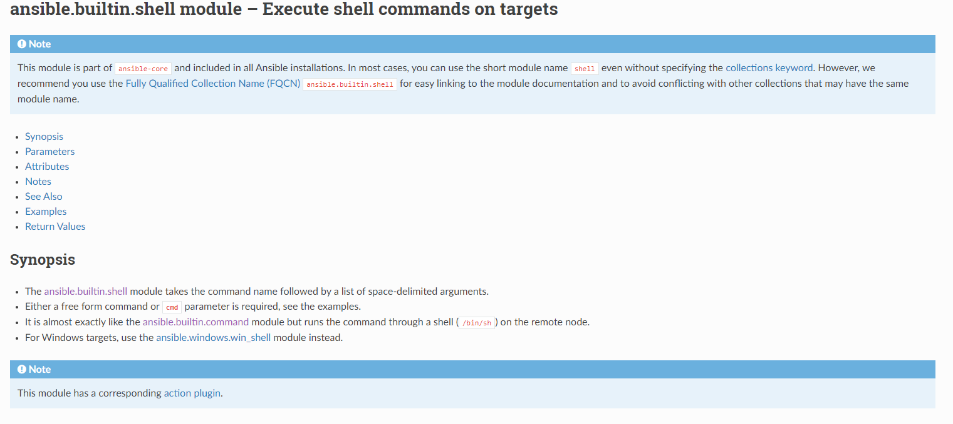

Slide 50
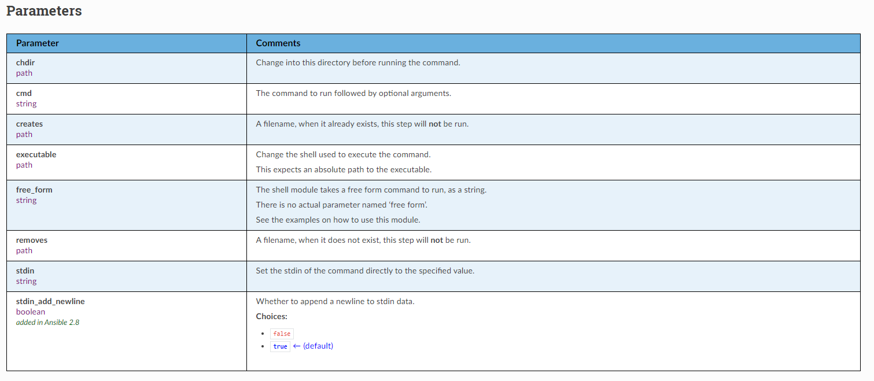

Slide 51
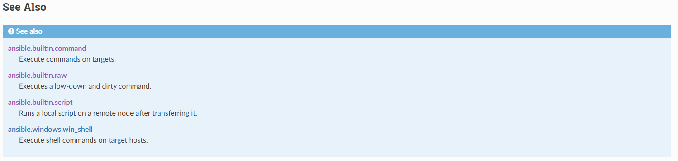
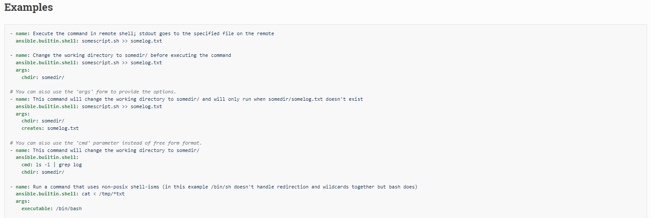

Slide 52
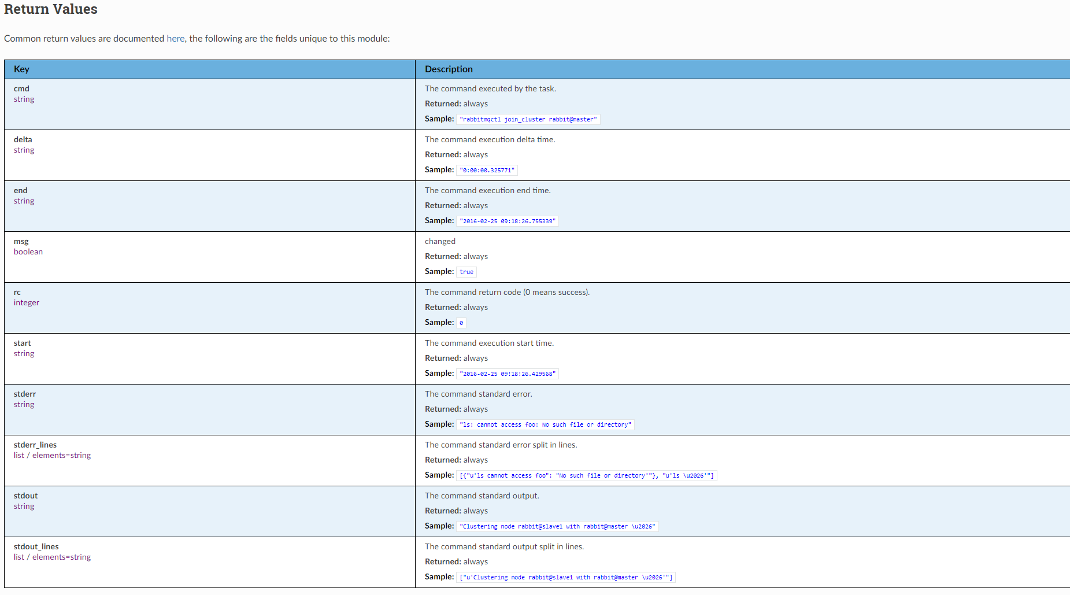

Slide 53
VI/VIm: basics
ESC: return to command mode
':set list' : display hidden caracters (space, tab, enter…)
i: insert text
I: insert text at start of line
a: append text
A: append text at end of line
o: insert new line down
O: insert new line up
x: delete character
dd: delete line
yy: copy line
p: paste line

Slide 54
Login: user
Password: <mot_de_passe>
Team 1 | team1-node1 team1-node2 | 192.0.2.11 192.0.2.12
 | team1-manager | 192.0.2.10
Team 2 | team2-node1 team2-node2 | 198.51.100.11 198.51.100.12
 | team2-manager | 198.51.100.10
Team 3 | team3-node1 team3-node2 | 203.0.113.11 203.0.113.12
 | team3-manager | 203.0.113.10

Slide 55
Exercice:
- get access to your environment with Ansible User
-Validate from Manager that you can ssh to all nodes
ssh-keygen
ssh-copy-id
- Validate that you can become root on all nodes
sudo
- install Ansible core on controller node
- setup inventory file:
add a group for all: MYSRVS
add a group for UBUNTU and ROCKY
- Validate your inventory
- ping your servers
- ping your Rocky Servers

Slide 56
Variables and facts
https://docs.ansible.com/ansible/latest/user_guide/playbooks_variables.html
Notes:
The real work. General format:
<<module>>: key=value
56

Slide 57
Definition:
  used to store values that can be reused throughout your playbooks and roles.
Purpose:
  help in making automation scripts more flexible and dynamic by allowing to change values without modifying the entire script.
Types of Variables:
  Playbook Variables: Defined within a playbook.
  Inventory Variables: Defined in the inventory file.
  Role Variables: Defined within roles.
  Extra Variables: Passed at runtime using the command line.
Usage:
  can be used to customize configurations, manage different environments, and handle sensitive data securely

Slide 58
Variables and facts : Ordering and precedence
Inventaire
    Groups
        Parent
        Enfants (ordre alphabetique)
    Host
Playbook
vars:
- mon_param: ma_Valeur
Set_facts:
mon_param: ma_Valeur
Command Line
ansible-playbook -i 127.0.0.1, -e mon_param1=ma_valeur1 playbook.yml
https://docs.ansible.com/ansible/latest/user_guide/playbooks_variables.html#ansible-variable-precedence

Slide 59
Vars:
- my_string: "toto"
- my_integer: 1234
- my_array: ["qwert", "asdfg", "zxcvb"]
- my_dict: { user: "toto", id: 1234, shell: "/sbin/bash"}
- name: Debug String and Int
debug:
msg: "{{ my_string }} {{ my_integer }}"
- name: Debug array
debug:
msg: "{{ my_array.0 }} {{ my_array[0] }}"
- name: Debug dict
debug:
msg: "{{ my_dict.user }} {{ my_dict['user'] }}"

Slide 60
Variables
Variables.yml
- name: Test
hosts: all
gather_facts: no
connection: local
vars:
- mon_param: set_in_playbook
- mon_param2: set_by_vecteur
tasks:
- name: facting
set_fact:
mon_param_0: "{{ inventory_hostname }}"
- name: resultat
debug:
msg: "Parameter defined in {{ mon_param_0 }} - {{ mon_param }}"
Variables-inventory.ini
[group]
SRV1 mon_param=set_by_host
SRV2
[group:vars]
mon_param=set_in_group
Notes:
The real work. General format:
<<module>>: key=value
60

Slide 61
Exercice:
- Identify precedence and priority of vars
ansible-playbook -i variables-inventory.ini variables.yml
ansible-playbook -i variables-inventory.ini -e mon_param=set_by_cli variables.yml
ansible-playbook -i variables-inventory.ini -e mon_param="{{ mon_param2 }}" variables.yml
- What is the precedence ordering?

Slide 62
Variables
Magic variables:
hostvars
group_names
groups
inventory_hostname
ansible_facts
Notes:
The real work. General format:
<<module>>: key=value
62

Slide 63
CONDITIONS
Exercice:
- What are the default facts?
- Add new facts like datacenter, project, environment, group
Notes:
Exemple fichier facts.d
Utilisation des variable “{{ nom }}”
<<module>>: key=value
63

Slide 64
Facts:
Group of facts/variables loaded from the remote hosts
- host: all
gather_facts: true
- tasks:
- setup:
filter: ansible_*

Slide 65
More Facts:
- tasks:
- ansible.builtin.set_fact:
my_fact: my_value
- tasks:
- ansible.builtin.include_vars:
file: "{{ my_vars_file }}"
name: my_value
- facts in remote host:
/etc/ansible/facts.d/*.fact
Ini file: /etc/ansible/facts.d/fact_file.fact
[my_category]
Key1=value1
Key2=value2
{{ ansible_local['fact_file']['my_category']['key1'] }}

Slide 66
CONDITIONS
Exercice:
- What are the default facts?
- Add new facts like datacenter, project, environment, group
- display the hostvars with gather_facts: no and yes
- found the key in hostvars where the default ip is defined
Notes:
hostvars[ inventory_hostname][‘ansible_default_ipv4’][‘address’]
Ansible_facts[‘ansible_default_ipv4’][‘address’]
Exemple fichier facts.d
Utilisation des variable “{{ nom }}”
<<module>>: key=value
66

Slide 67
CONDITIONS
Exercice:
- What are the default facts?
- Add new facts like datacenter, project, environment, group
- display the hostvars with gather_facts: no and yes
found the key in hostvars where the default ip is defined
hostvars[ inventory_hostname] => ansible_facts ['ansible_default_ipv4']['address']
Ansible_facts['ansible_default_ipv4']['address']
Notes:
hostvars[ inventory_hostname][‘ansible_default_ipv4’][‘address’]
Ansible_facts[‘ansible_default_ipv4’][‘address’]
Exemple fichier facts.d
Utilisation des variable “{{ nom }}”
<<module>>: key=value
67

Slide 68
errors
Error handling
Notes:
The real work. General format:
<<module>>: key=value
68

Slide 69
Definition: Error handling in Ansible involves managing and responding to errors that occur during the execution of playbooks.
Purpose: It ensures that your automation scripts can gracefully handle failures, providing resilience and reliability.
Key Concepts:
  ignore_errors: Allows tasks to continue even if they fail.
  failed_when: Custom conditions to define when a task should be considered failed.
  rescue: A block to execute tasks if an error occurs.
  always: A block to execute tasks regardless of success or failure.
Usage Examples:
  Ignoring Errors: ignore_errors: yes

Slide 70
errors
What my module return:
- name: Do Someyhing
Command: test_command -x -y -z
Register: result
Notes:
The real work. General format:
<<module>>: key=value
70

Slide 71
errors
Ignoring errors:
- name: ping host
Command: ping -c1 www.google.com
Register: result
ignore_errors: yes
Notes:
The real work. General format:
<<module>>: key=value
71

Slide 72
errors
Define error reason:
- name: ping host
ansible.builtin.command: test_command -x -y -z
register: result
failed_when: "'FAILED' in result.stdout"
Notes:
The real work. General format:
<<module>>: key=value
72

Slide 73
errors
Define changed reason:
- name: ping host
ansible.builtin.command: test_command -x -y -z
register: result
changed_when: "'FAILED' in result.stdout"
Notes:
The real work. General format:
<<module>>: key=value
73

Slide 74
errors
Blocks:
tasks:
- name: my block
block:
- debug: msg="start block execution"
- Command: test_command2 -x -y -z
- Command: test_command3 -x -y -z
rescue:
- debug: msg="an error occurs"
- Command: error_command
Always:
- debug: msg="always execution bock"
- Command: always_command
Notes:
The real work. General format:
<<module>>: key=value
74

Slide 75
Filtres
Exercice:
- Write a playbook :
- check connectivity by accessing URL without proxy
- if failed,
- check connectivity by accessing URL with proxy
- define global_proxy fact when not failed
Test: https://gitlab.com
Proxy: http://proxy.example.com:8080
Notes:
The real work. General format:
<<module>>: key=value
75

Slide 76
- name: Check connectivity and define proxy
hosts: all
tasks:
- block:
- name: Check connectivity without proxy
uri:
url: https://gitlab.com
use_proxy: no
return_content: no
rescue:
- name: Check connectivity with proxy(deuxième tentative)
uri:
url: https://gitlab.com
use_proxy: yes
return_content: no
environment:
https_proxy: "http://proxy.example.com:8080"
- name: define global proxy
set_fact:
global_proxy: "http://proxy.example.com:8080"

Slide 77
Delegation
https://docs.ansible.com/ansible/latest/user_guide/become.html
Notes:
The real work. General format:
<<module>>: key=value
77

Slide 78
Definition: allow to execute tasks on a different host than the one specified
Purpose: help in managing tasks that need to be performed on a control node or a different host, ensuring efficient and precise management of inter-related environments.
Key Concepts:
  delegate_to: used to specify the host on which a task should be executed.
  local_action: A shorthand syntax for delegating tasks to the local machine.
Usage Examples:
  Load Balancer Management: Add/Remove web servers from a load-balanced pool.
  File Synchronization: Using RSYNC to copy files from the management server to target servers.
Benefits: enhance flexibility, allowing for complex orchestration and better control over task execution.

Slide 79
Execute task on other host than the inventory one:
local_action : module to execute an other module locally
delegate_to : host
The task will be executed ont the server ‘host’ instead of the current one
delegated_facts : true/false
The facts are the one of the delegated server instead of the current one
Execute task from a different user:
become
set to yes to activate privilege escalation.
become_user
  set to user with desired privileges — the user you become,
become_method
  overrides the default method to set to sudo/su/pbrun/pfexec/doas/dzdo/ksu/runas
become_flags
permit the use of specific flags for the tasks or role.
One common use is to change the user to nobody when the shell is set to no login

Slide 80
Exercice:
- ping inventory hosts
- add hostname in /tmp/hosts of the controller

Slide 81
---
- hosts: all
gather_facts: no
tasks:
- name: Ping inventory hosts
ping:
#register: myping
- name: Add hostname to /tmp/hosts on the controller
local_action:
module: lineinfile
path: /tmp/hosts
line: "{{ inventory_hostname }}"
#when: myping.ok is useless
#delegate_to: localhost
#connection: local

Slide 82
Filtres
https://docs.ansible.com/ansible/latest/user_guide/playbooks_filters.html
Notes:
The real work. General format:
<<module>>: key=value
82

Slide 83
Definition: Filters in Ansible are used to transform and manipulate data within your playbooks and templates.
Purpose: They enhance the flexibility and power of your automation scripts by allowing you to format, modify, and manage data dynamically.
Key Concepts:
  Jinja2 Filters: Ansible uses Jinja2 templating, which includes a wide range of built-in filters.
  Custom Filters: You can create your own filters to meet specific needs.
Common Filters:
  Formatting Data: to_json, to_yaml
  Handling Undefined Variables: default, mandatory
  String Manipulation: split, replace
  Math Operations: abs, round
Usage Examples:
  Default Values: {{ some_variable | default('default_value') }}
  String Operations: {{ 'hello world' | upper }}
Benefits: Filters simplify data handling, improve readability, and reduce the complexity of your playbooks.

Slide 84
Filtres
Modification and Format:
to(_nice)_json / to(_nice)_yaml
from_json / from_yaml
{{ ma_variable|to_json }}
{{ an_other|from_yaml }}
Notes:
The real work. General format:
<<module>>: key=value
84

Slide 85
Filtres
Mandatory
{{ ma_variable|mandatory("var requited") }}
default(default_var)
{{ my_other|default(1234) }}
Notes:
The real work. General format:
<<module>>: key=value
85

Slide 86
Filtres
flatten
{{ [1,[2,3]]|flatten }}
Min, max,
{{ other_variable|min }}
Notes:
The real work. General format:
<<module>>: key=value
86

Slide 87
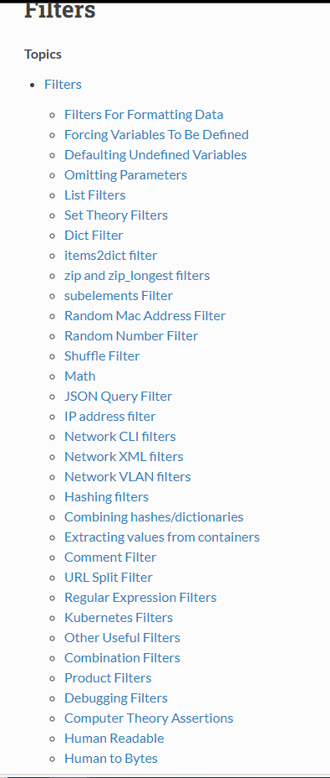
https://docs.ansible.com/ansible/2.9/user_guide/playbooks_filters.html#

Slide 88
Filtres
Exercice:
- Write a playbook to add a user with variables:
  - a mandatory name
  - a group as “nobody” if not provided
ansible-playbook -i inventory set_user.yml -e user_name="toto" [-e user_group="titi"]
ansible-playbook -i inventory set_user.yml -e "user_name='toto' user_group='titi'"
Notes:
The real work. General format:
<<module>>: key=value
88

Slide 89
---
- hosts: all
become: true
vars:
The_Name: "{{ user_name | mandatory('user_name must be defined') }}"
The_Group: "{{ user_group | default('nobody') }}"
tasks:
- name: set Group
ansible.builtin.group:
name: "{{ The_Group }}"
state: present
- name: Add user with specified or default group
ansible.builtin.user:
name: "{{ The_Name }}"
group: "{{ The_Group }}"
state: present

Slide 90
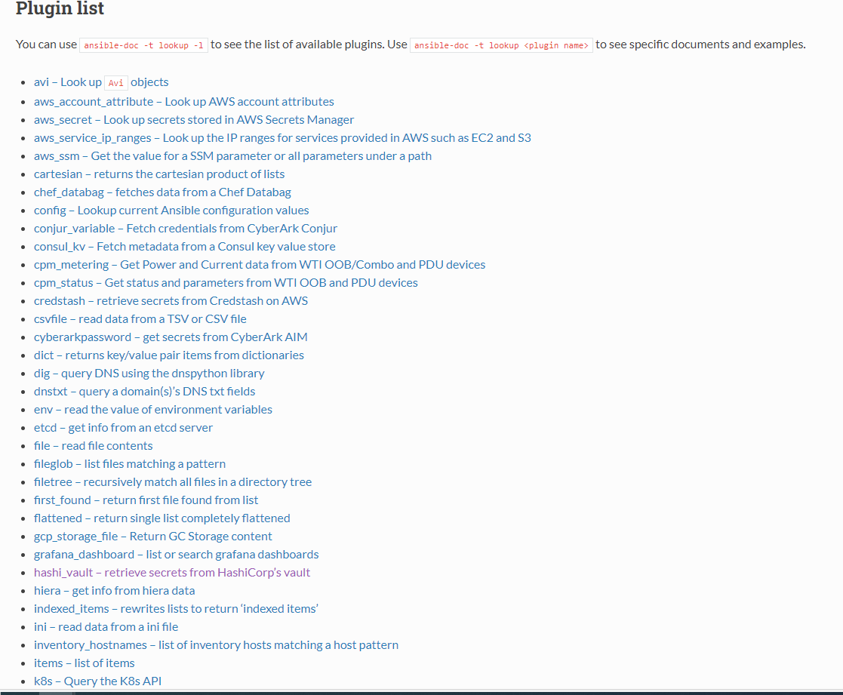
https://docs.ansible.com/ansible/2.9/plugins/lookup.html#plugin-list

Slide 91
CONDITIONS
https://docs.ansible.com/ansible/latest/user_guide/playbooks_conditionals.html
Notes:
The real work. General format:
<<module>>: key=value
91

Slide 92
Definition: Conditions in Ansible allow you to control the execution of tasks based on specific criteria.
Purpose: They enable more dynamic and flexible playbooks by executing tasks only when certain conditions are met.
Key Concepts:
  when: A keyword used to specify conditions for task execution.
  register: Used to store the result of a task, which can then be used in conditions.
  failed_when and changed_when: Custom conditions to define task failure or change status.
Usage Examples:
  Simple Condition: when: ansible_os_family == 'Debian'

Slide 93
CONDITIONS EXAMPLE
---
- name: install and start apache
hosts: WEB
vars:
http_port: 80
max_clients: 200
remote_user: root
tasks:
- name: install httpd
yum: pkg=httpd state=latest
- name: write the apache config file
template: src=/srv/httpd.j2 dest=/etc/httpd.conf
register: APACHE
- name: start httpd
service: name=httpd state=restarted
when: APACHE.changed == true
Notes:
The real work. General format:
<<module>>: key=value
93

Slide 94
When Task generate a change:
---
- name: update all pkgs
tags:
- prepare
ansible.builtin.dnf:
name: "*"
state: latest
- name: check if REBOOT needed
ansible.builtin.shell: test $(rpm -q --last kernel | sed 's/^kernel-\(.*\) .*/\1/'|head -1) == $(uname -r)
register: reboot_needed
ignore_errors: true
- name: restart machine
ansible.builtin.shell: sleep 2 && shutdown -r now "Ansible updates triggered"
async: 1
poll: 0
become: true
ignore_errors: true
when: reboot_needed is failed
Notes:
The real work. General format:
<<module>>: key=value
94

Slide 95
CONDITIONS EXAMPLE
---
- name: update all pkgs
yum: state=latest name=*
- name: check if REBOOT needed
shell: test $(rpm -q --last kernel | sed 's/^kernel-\(.*\) .*/\1/'|head -1) == $(uname -r)
notify: restart machine
ignore_errors: true
- name: update grub and kernel default values
shell: update_boot_parameters
notify: restart machine
ignore_errors: true
Handlers:
- name: restart machine
reboot:
- name: restarted server
listen: restart machine
debug:
msg: " {{ inventory_hostname }} REBOOTED"
Notes:
Notify on chqnged ou failed?
95

Slide 96
CONDITIONS EXAMPLE
Conditionals
* The When Statement
* Loops and Conditionals
* Loading Custom Facts
* Applying ‘when’ to roles and includes
* Conditional Imports
* Selecting Files And Templates Based On Variables
* Register Variables
Notes:
The real work. General format:
<<module>>: key=value
96

Slide 97
CONDITIONS Exercice
Exercice:
- Write a playbook:
- check internet access
- set proxy variables if needed
- reboot with handler if proxy updated
Update /etc/environment:
http_proxy= http://proxy.example.com:8080
https_proxy= http://proxy.example.com:8080
Notes:
The real work. General format:
<<module>>: key=value
97

Slide 98
- name: Check internet access and set proxy if needed
hosts: all
tasks:
- name: Check internet access without proxy
uri:
url: http://gitlab.com
return_content: no
register: internet_check
ignore_errors: yes
- name: Set proxy variables if internet access fails
lineinfile:
dest: /etc/environment
regexp: "^{{ item.var }}="
line: "{{ item.var }}={{ item.value }}"
state: present
loop:
- { var: 'http_proxy', value: 'http://proxy.example.com:8080' }
- { var: 'https_proxy', value: 'http://proxy.example.com:8080' }
when: internet_check.failed
notify: Reboot_Required
handlers:
- name: Reboot the machine
Listen: Reboot_Required
reboot:
msg: "Reboot required after proxy update"

Slide 99
Loops
https://docs.ansible.com/ansible/latest/user_guide/playbooks_loops.html
Notes:
The real work. General format:
<<module>>: key=value
99

Slide 100
Definition: Loops in Ansible allow you to execute a task multiple times with different items, making your playbooks more efficient and concise.
Purpose: They help automate repetitive tasks, reducing the need for manual intervention and minimizing errors.
Key Concepts:
  loop: The primary keyword for creating loops in Ansible.
  with_items: An older syntax for loops, still supported but less recommended.
  until: Used for retrying a task until a condition is met.
Benefits: Loops enhance the scalability and maintainability of your playbooks, allowing for more dynamic and flexible automation.

Slide 101
LOOP EXAMPLE
---
- name: install pkgs
package: state=installed name={{ item }}
loop:
- rsyslog
- ntp
- gpm
- bash-completion
- screen
- deltarpm
=> equivalent à with_item
Notes:
The real work. General format:
<<module>>: key=value
101

Slide 102
loop EXAMPLE
---
- name: setup myapp
ansible.builtin.lineinfile:
state: present
path: /etc/myapp.cfg
line: "{{ item['entry'] }} {{ item['column'] }}"
loop:
- { entry: image_path , column: /opt/myapp/images }
- { entry: local_ip , column: "{{ deploy_network }}.35/24" }
- { entry: network_gateway , column: "{{ deploy_network }}.35" }
- { entry: public_vip , column: "{{ deploy_network }}.10" }
- { entry: local_interface , column: "eth0"}
Notes:
The real work. General format:
<<module>>: key=value
102

Slide 103
loop with together
vars:
users:
- user1
- user2
- user4
groups:
- group1
- group2
- group3
loop: "{{ users |zip(groups)|list}}"
item=['user1', 'group1']
item=['user2', 'group2']
item=['user3', 'group3']
=> equivalent à with_together
Notes:
The real work. General format:
<<module>>: key=value
103

Slide 104
loop with nested :
vars:
users:
- user1
- user2
- user3
groups:
- group1
- group2
- group3
loop: "{{ list1 |product(list2)|list}}"
item=['user1', 'group1']
item=['user1', 'group2']
item=['user1', 'group3']
item=['user2', 'group1']
item=['user2', 'group2']
item=['user2', 'group3']
item=['user3', 'group1']
item=['user3', 'group2']
item=['user3', 'group3']
=> equivalent à with_nested
Notes:
The real work. General format:
<<module>>: key=value
104

Slide 105
Loop_control:
pause: 3
index_var: my_index
loop_var: my_item

Slide 106
loop DO-UNTIL
- shell: /usr/bin/foo
register: result
until: result.stdout.find("all systems go") != -1
retries: 5
delay: 10
Notes:
The real work. General format:
<<module>>: key=value
106

Slide 107
loop EXAMPLE
So many maner to loop:
*Standard Loops *Nested Loops
*Looping over Hashes *Looping over Files
*Looping over Fileglobs *Looping over Parallel Sets of *Data
*Looping over Subelements *Looping over Integer Sequences
*Random Choices *Iterating Over The Results of a Program Execution
*Finding First Matched Files *Do-Until Loops
*Looping Over A List With *Using ini file with a loop
An Index
*Flattening A List *Using register with a loop
*Looping over the inventory *Loop Control
*Loops and Includes in 2.0 *Writing Your Own Iterators
Notes:
The real work. General format:
<<module>>: key=value
107

Slide 108
EXERCICE
Exercice:
- update /etc/hosts with ALL your servers
<ip> <hostname>
- add a host GOOGLE.COM 8.8.8.8
hostvars[inventory_hostname]['ansible_default_ipv4']['address']
Notes:
hostvars[inventory_hostname][‘ansible_default_ipv4’][‘address’]
<<module>>: key=value
108

Slide 109
---
- name: Update /etc/hosts
hosts: all
become: yes
tasks:
- name: Update /etc/hosts with all servers and add/change GOOGLE.COM
lineinfile:
path: /etc/hosts
line: "{{ hostvars[item]['ansible_default_ipv4']['address'] }} {{ item }}"
loop: "{{ groups['all'] }}"

Slide 110
---
- name: Update /etc/hosts
hosts: all
become: yes
tasks:
- name: Update /etc/hosts with all servers and add/change GOOGLE.COM
lineinfile:
path: /etc/hosts
line: "{{ item.ip }} {{ item.hostname }}"
loop: >
{{
groups['all'] | map('extract', hostvars, ['ansible_default_ipv4', 'address']) | map('community.general.dict_kv', 'hostname', inventory_hostname, 'ip') | list
+ [{'hostname': 'google.com', 'ip': '8.8.8.8'}]
}}
- { ‘hostname’: “node1.example.com”, “ip; ”192.0.2.139”}
- { ‘hostname’: “google.comm”, “ip; ”8.8.8.8”}

Slide 111
Exercice:
host_groups:
HG-1-DC1:
- id: 1
name: lun1
- id: 2
name: lun_18
HG-2-DC1 :
- id: 1
name: lun_432
- id: 2
name: lun_123
Do a playbook that loop over all
- declare a fact <id>-<name>@<parent_group_name>
- display the content of the fact
Notes:
Transpose into Inventory and hostvars:

Slide 112
---
- hosts: localhost
gather_facts: no
tasks:
- name: Loop over host_groups and declare facts
set_fact:
custom_fact: "{{ item.1.id }}-{{ item.1.name }}@{{ item.0 }}"
loop: "{{ lookup('dict', host_groups) }}"
register: custom_facts
- name: Display the content of the facts
debug:
msg: "{{ item.custom_fact }}"
loop: "{{ custom_facts.results }}"

Slide 113
Tags
https://docs.ansible.com/ansible/latest/user_guide/playbooks_tags.html

Slide 114
Definition: Tags in Ansible are used to label tasks, allowing you to selectively run or skip specific parts of your playbooks.
Purpose: They provide a way to manage and control the execution of tasks, making your automation scripts more modular and efficient.
Save time by avoiding re-execution of already completed tasks.
Facilitate debugging by isolating specific sections of the playbook.
Key Concepts:
  Defining Tags: Assign tags to tasks using the tags keyword.
  Running Tagged Tasks: Use the --tags option to run only tasks with specific tags.
  Skipping Tagged Tasks: Use the --skip-tags option to skip tasks with specific tags.
Benefits: Tags enhance the flexibility and manageability of your playbooks, allowing for targeted execution and easier debugging.

Slide 115
How to Add Tags
Adding tags to individual tasks:
Adding tags to blocks of tasks:
tasks:
- name: Install Apache
apt:
name: apache2
state: present
tags:
- installation
- webserver
tasks:
- block:
- name: Install NTP
apt:
name: ntp
state: present
- name: Configure NTP
template:
src: ntp.conf.j2
dest: /etc/ntp.conf
tags:
- ntp

Slide 116
Using Tags
Executing specific tasks with tags:
Use the --tags option to execute only tasks marked with at least one specific tag.
ansible-playbook playbook.yml --tags "installation"
Skipping specific tasks with tags:
Use the --skip-tags option to skip tasks marked with a specific tag.
ansible-playbook playbook.yml --skip-tags "configuration"
Using -tags and -skip-tags:
When a task is tagged with both tags and skip-tags; the skip-tags take precedence and the task is skipped

Slide 117
Special Tags
Special tags in Ansible:
always: Tasks marked with this tag will always be executed, even if other tags are specified.
never: Tasks marked with this tag will never be executed, unless the always tag is also present.
tagged: Executes only tasks that have tags, ignoring those without tags.
Example
tasks:
- name: Task always executed
command: echo "This task is always executed"
tags:
- always
- name: Task never executed
command: echo "This task is never executed"
tags:
- never
- name: Task with tag
command: echo "This task has a tag"
tags:
- tagged

Slide 118
CONDITIONS Exercice
Exercice:
- Create a playbook with the following tasks:
  Install MySQL
  Configure MySQL
  Start the MySQL service
Add appropriate tags to each task.
Execute only the installation tasks using the tags.
Notes:
The real work. General format:
<<module>>: key=value
118

Slide 119
Solution:
---
- name: MySQL Deployment
hosts: databases
tasks:
- name: Install MySQL
apt:
name: mysql-server
state: present
tags:
- installation
- mysql
- name: Configure MySQL
template:
src: my.cnf.j2
dest: /etc/mysql/my.cnf
tags:
- configuration
- mysql
- name: Start MySQL service
service:
name: mysql
state: started
tags:
- service
- mysql
Exécuter uniquement les tâches d’installation :
ansible-playbook playbook.yml --tags "installation"
Ignorer les tâches de configuration :
ansible-playbook playbook.yml --skip-tags "configuration"

Slide 120
Templates
https://docs.ansible.com/ansible/latest/playbook_guide/playbooks_templating.html
https://jinja.palletsprojects.com/en/latest/templates/
Notes:
The real work. General format:
<<module>>: key=value
120

Slide 121
What is Jinja?
  Jinja is a powerful templating engine for Python, widely used in web development and automation tools like Ansible.
Purpose of Jinja Templates:
  Jinja templates allow you to create dynamic content by embedding variables and expressions within text files.
Key Features:
  Variables: Embed dynamic data using{{ ... }}
  Control Structures: Use {% ... %} for loops, conditionals, and more.
  Filters: Modify variables with built-in filters like {{ variable | filter }}
  Comments: Add comments with {# ... #}that won’t appear in the output.
Why Use Jinja with Ansible?
  Dynamic Configuration: Generate configuration files dynamically based on variables and conditions.
  Reusability: Create reusable templates for different environments and scenarios.
  Flexibility: Easily integrate with Ansible playbooks to automate complex tasks.

Slide 122
Templates
Variable:
{{ variable }}
{{ hostvars[server].ansible_default_ipv4.address }}
Action:
{% action %}
{% endaction %}
Notes:
The real work. General format:
<<module>>: key=value
122

Slide 123
Templates
Loop:
{% for server in groups.webservers %}
Server{{ loop.index }} {{ server }}
{% endfor %}
Notes:
The real work. General format:
<<module>>: key=value
123

Slide 124
Templates
Conditions:
{% if ansible_processor_core >=2 %}
- smp: enable
{% else %}
- smp: disable
{% endif %}
{% if my_variable is defined %}
Notes:
The real work. General format:
<<module>>: key=value
124

Slide 125
Templates
Filtres:
{% set my_var='mon-premier-test' %}
{{ my_var|replace('-',' ') }}
{% set servers='server1,server2,server3' %}
{% for server in servers.split(',') %}
{{ server }}
{% endfor %}
Notes:
The real work. General format:
<<module>>: key=value
125

Slide 126
Templates
EXAMPLE
Template/environment.j2
http_proxy="{{ proxy_url }}"
https_proxy="{{ proxy_url }}"
Tasks:
template:
src: Template/environment.j2
dest: /etc/environment
Notes:
The real work. General format:
<<module>>: key=value
126

Slide 127
Templates
Exercice:
Build the /etc/hosts
from a template
based on inventory
Local hosts must be defined:
127.0.0.1 localhost localhost.localdomain
::1 localhost localhost.localdomain
Notes:
The real work. General format:
<<module>>: key=value
127

Slide 128
---
- name: Update /etc/hosts
hosts: all
become: yes
tasks:
- name: Update /etc/hosts with all servers and add/change GOOGLE.COM
lineinfile:
path: /etc/hosts
line: "{{ hostvars[item]['ansible_default_ipv4']['address'] }} {{ item }}"
loop: "{{ groups['all'] }}"
# /etc/hosts template
127.0.0.1 localhost localhost.localdomain
::1 localhost localhost.localdomain
{% for host in groups['all'] %}
{{ hostvars[host]['ansible_default_ipv4']['address'] }} {{ host }} {{ hostvars[host]['ansible_hostname'] }}
{% endfor %}
---
- hosts: all
become: yes
tasks:
- name: Generate /etc/hosts file from template
template:
src: hosts.j2
dest: /etc/hosts
when: hostvars[inventory_hostname]['ansible_default_ipv4'] is defined

Slide 129
Asynchroneous:
https://docs.ansible.com/ansible/latest/user_guide/playbooks_async.html
Notes:
The real work. General format:
<<module>>: key=value
129

Slide 130
What Does Asynchronous Mean?
  Asynchronous operations do not occur at the same time. They allow tasks to run independently of the main program flow.
Importance in Programming:
  Asynchronous programming is crucial for improving the efficiency and responsiveness of applications, especially in I/O-bound and high-latency operations.
Key Concepts:
  Concurrency: Multiple tasks make progress without waiting for each other.
  Non-blocking: Operations that do not block the execution of other tasks.
  Callbacks, Promises, and Async/Await: Mechanisms to handle asynchronous code in various programming languages.
Why Use Asynchronous Programming?
  Performance: Enhances the performance of applications by allowing multiple operations to run concurrently.
  User Experience: Improves the responsiveness of applications, providing a smoother user experience.
  Scalability: Helps in building scalable applications that can handle numerous simultaneous operations efficiently.

Slide 131
Asynchroneous
Run tasks in background until timeout:
tasks:
- name: simulate long running op (15 sec), wait for up to 45 sec, poll every 5 sec
command: /bin/sleep 15
async: 45
poll: 5
poll: 5 seconds
Async: 45 seconds
Notes:
The real work. General format:
<<module>>: key=value
131

Slide 132
Asynchrone
Run tasks in background:
- name: 'YUM - async task'
yum:
name: docker-io
state: installed
async: 1000
poll: 0
register: yum_sleeper
Check and wait for task end:
- name: 'YUM - check on async task'
async_status:
jid: "{{ yum_sleeper.ansible_job_id }}"
register: job_result
until: job_result.finished
retries: 30
delay: 10
Notes:
The real work. General format:
<<module>>: key=value
132

Slide 133
Exercice:
Upgrade packages
Print “Upgrade ongoing”
- Wait for upgrade done
- Reboot
- Wait for server UP
- Print « All done »
Notes:
The real work. General format:
<<module>>: key=value
133

Slide 134
---
- hosts: all
become: yes
tasks:
- name: Upgrade packages
yum:
name: "*"
state: latest
register: upgrade_result
async: 3600
poll: 0
- name: Print completion message
debug:
msg: "Upgrade ongoing "
- name: Wait for upgrade to complete
async_status:
jid: "{{ upgrade_result.ansible_job_id }}"
register: job_result
until: job_result.finished
retries: 30
delay: 60
- name: Reboot the server
reboot:
msg: "Reboot initiated by Ansible"
pre_reboot_delay: 10
post_reboot_delay: 30
reboot_timeout: 600
- name: Wait for server to come back up
wait_for_connection:
timeout: 300
- name: Print completion message
debug:
msg: "All done"

Slide 135
Vault
Vault:
https://docs.ansible.com/ansible/latest/user_guide/vault.html
Notes:
The real work. General format:
<<module>>: key=value
135

Slide 136
What is Ansible Vault?
  Ansible Vault is a feature within Ansible that allows you to securely store and manage sensitive data such as passwords, keys, and other secrets.
Purpose of Ansible Vault:
  It enables encryption of variables, files, and entire playbooks to protect sensitive information from unauthorized access.
Key Features:
  Encryption and Decryption: Encrypt and decrypt files and variables using a password or key.
  Integration: Seamlessly integrate encrypted data into your playbooks and roles.
  Flexibility: Encrypt entire files or specific variables within a file.
  Access Control: Control who can access and modify the encrypted data.
Why Use Ansible Vault?
  Security: Protect sensitive information within your automation scripts and playbooks.
  Compliance: Ensure compliance with security policies by encrypting sensitive data.
  Ease of Use: Easily integrate encrypted data into your existing Ansible workflows without significant changes.

Slide 137
VAULT
- store secured values in a crypted file
- encrypt the secured value
Notes:
The real work. General format:
<<module>>: key=value
137

Slide 138
VAUL file
Store in a sidekick encrypted file:
$ ansible-vault create --vault-id test1@prompt vault1
$ ansible-vault edit --vault-id test1@prompt vault1
$ ansible-vault encrypt --vault-id test2@prompt inventaire
Notes:
The real work. General format:
<<module>>: key=value
138

Slide 139
VAULT vars
Store encrypted var in any var storage place:
$ ansible-vault encrypt_string --vault-id test1@prompt \
'mon_password_secret' --name 'password'
password: !vault |
$ANSIBLE_VAULT;1.2;AES256;test1
62313365396662343061393464336163383764373764613633653634306231386433626436623361
6134333665353966363534333632666535333761666131620a663537646436643839616531643561
63396265333966386166373632626539326166353965363262633030333630313338646335303630
3438626666666137650a353638643435666633633964366338633066623234616432373231333331
6564
ansible-playbook --ask-vault-pass --vault-id test1 -i inventory.yml my_playbook.yml
ansible-playbook --vault-password-file /tmp/my_file.sh --vault-id test1 -i inventory.yml my_playbook.yml
Notes:
The real work. General format:
<<module>>: key=value
139

Slide 140
Exercice:
Create inventory file with :
- user and password connection encrypted
(ansible_user, ansible_password)
ansible-playbook --ask-vault-pass --vault-id test1 -i inventory.yml my_playbook.yml
Ini:
[group:var]
Ansible_user=!vault ……
Yaml:
All:
hosts:
…..
vars:
ansible_user: !vault…..
Notes:
The real work. General format:
<<module>>: key=value
140

Slide 141
ansible-vault encrypt_string 'myuser' --name 'ansible_user' --vault-id user_key@prompt
ansible-vault encrypt_string 'mypassword' --name 'ansible_password' --vault-id pass_key@prompt
---
- hosts: all
tasks:
- name: Test connection
ping:
all:
hosts:
server1:
ansible_host: 192.168.1.10
ansible_user: !vault |
$ANSIBLE_VAULT;1.1;AES256;user_key
62313365396662343061393464336163383764373764613633653634306231386433626436623361
6134333665353966363534333632666535333761666131620a663537646436643839616531643561
63396265333966386166373632626539326166353965363262633030333630313338646335303630
3438626666666137650a353638643435666633633964366338633066623234616432373231333331
6564
ansible_password: !vault |
$ANSIBLE_VAULT;1.1;AES256;pass_key
62313365396662343061393464336163383764373764613633653634306231386433626436623361
6134333665353966363534333632666535333761666131620a663537646436643839616531643561
63396265333966386166373632626539326166353965363262633030333630313338646335303630
3438626666666137650a353638643435666633633964366338633066623234616432373231333331
6564
server2:
ansible_host: 192.168.1.11
ansible_user: !vault |
$ANSIBLE_VAULT;1.1;AES256;user_key
62313365396662343061393464336163383764373764613633653634306231386433626436623361
6134333665353966363534333632666535333761666131620a663537646436643839616531643561
63396265333966386166373632626539326166353965363262633030333630313338646335303630
3438626666666137650a353638643435666633633964366338633066623234616432373231333331
6564
ansible_password: !vault |
$ANSIBLE_VAULT;1.1;AES256;pass_key
62313365396662343061393464336163383764373764613633653634306231386433626436623361
6134333665353966363534333632666535333761666131620a663537646436643839616531643561
63396265333966386166373632626539326166353965363262633030333630313338646335303630
3438626666666137650a353638643435666633633964366338633066623234616432373231333331
6564
ansible-playbook playbook.yml --ask-vault-pass -i inventory.yml

Slide 142
Ansible Roles:
  a way to organize playbooks and other Ansible content by grouping related tasks, variables, files, templates, and modules into reusable units.
Purpose of Roles:
  Simplify the management of complex playbooks by breaking them down into smaller, reusable components.
  Promote reusability and maintainability of Ansible code.

Slide 143
Ansible Collections:
The standard way to distribute and manage Ansible content.
Key Features:
  Content Organization: Organize roles, modules, and plugins into logical groups.
  Versioning: Manage multiple versions of your content and track changes.
  Dependency Management: Easily declare and manage dependencies between collections.
  Certification: Ensure your collections meet Ansible's quality and security standards.
Why Use Collections?
  Modularity: Break down complex automation projects into reusable, modular components.
  Reusability: Share and reuse content across multiple projects and teams.
  Simplification: Simplify your automation workflow by managing dependencies and versions in one place.

Slide 144
Ansible Galaxy:
  public repository for sharing Ansible roles and collections.
Key Features:
  Role Discovery: Search and download roles from the Galaxy website or using the ansible-galaxy command.
  Community Contributions: Access a wide range of roles contributed by the Ansible community.
  Role Management: Easily manage roles and collections within your Ansible projects.
Why Use Roles and Galaxy?
  Efficiency: Save time by reusing existing roles instead of writing everything from scratch.
  Collaboration: Leverage the collective knowledge and contributions of the Ansible community.
  Scalability: Organize and scale your automation projects more effectively by using roles and collections.

Slide 145
Re-usable: Role
Roles are ways of automatically loading vars_files, tasks, and handlers
based on a known file structure.
Grouping content by roles also allows easy sharing of roles with other users.
- name: my installer
hosts: all
roles:
- role: configure SSH
- role: secure OS
- role: install APACHE
- role: secure APACHE
- name: my installer
hosts: all
tasks:
- include_role: {name: configure SSH} <= Dynamic Role
- import_role: {name: secure OS} <= Static Role
Notes:
The real work. General format:
<<module>>: key=value
145

Slide 146
Re-uasable: Role
roles/
common/ # this hierarchy represents a "role"
tasks/ #
main.yml # <-- tasks file can include smaller files if warranted
handlers/ #
main.yml # <-- handlers file
templates/ # <-- files for use with the template resource
ntp.conf.j2 # <------- templates end in .j2
files/ #
bar.txt # <-- files for use with the copy resource
foo.sh # <-- script files for use with the script resource
vars/ #
main.yml # <-- variables associated with this role
defaults/ #
main.yml # <-- default lower priority variables for this role
meta/ #
main.yml # <-- role dependencies
library/ # roles can also include custom modules
module_utils/ # roles can also include custom module_utils
lookup_plugins/ # or other types of plugins, like lookup in this case
webtier/ # same kind of structure as "common" was above, done for the webtier role
monitoring/ # ""
fooapp/ # ""
Notes:
The real work. General format:
<<module>>: key=value
146

Slide 147
Re-usable: Role Documentation
Roles are shared => needs and must be documented
meta/argument_specs.yml
---
argument_specs:
# roles/myapp/tasks/main.yml entry point
main:
short_description: Main entry point for the myapp role
description:
- human readable description.
author:
- Cyril Coupel
options:
myapp_int:
type: "int"
required: false
default: 42
description:
- "The integer value, defaulting to 42."
- "This is a second paragraph."
Notes:
The real work. General format:
<<module>>: key=value
147

Slide 148
Re-usable: Collection
mynamespace/
└── mycollection/
├── docs/
├── galaxy.yml
├── plugins/
│ ├── modules/
│ │ └── module1.py
│ ├── inventory/
│ └── .../
├── README.md
├── roles/
│ ├── role1/
│ ├── role2/
│ └── .../
├── playbooks/
│ ├── files/
│ ├── vars/
│ ├── templates/
│ └── tasks/
└── tests/
mynamespace.mycollection.role1

Slide 149
Re-usable: Collection
Step 1: Create a new collection
  Create a new directory for your collection and navigate into it: `mkdir my_collection && cd my_collection`
  Initialize the collection using `ansible-galaxy collection init my_namespace.my_collection`
Step 2: Create a new role within the collection
  Create a new directory for your role within the collection: `mkdir roles/my_role`
  Navigate into the role directory: `cd roles/my_role`
  Initialize the role using `ansible-galaxy role init my_role`
Step 3: Develop your role
  Write your role's code in the `tasks`, `handlers`, `templates`, and `defaults` directories
  Test your role locally using `ansible-playbook -i <hosts_file> <playbook_file>`
Step 4: Configure your collection
  In the collection's root directory, edit the `galaxy.yml` file to include information about your collection and role
  Add the following lines to the `galaxy.yml` file:
roles:
- my_role
Step 5: Build your collection
  Run `ansible-galaxy collection build` to build your collection
  This will create a `my_namespace-my_collection-<version>.tar.gz` file in the collection's root directory
Step 6: Publish your collection to Ansible Galaxy
  Run `ansible-galaxy collection publish` to upload your collection to Ansible Galaxy
  Run `ansible-galaxy collection publish --server <your_automation_hub_url> --token <your_api_token> my_namespace-my_collection-<version>.tar.gz`

Slide 150
Ansible-doc Overview
Description:
ansible-doc displays information about installed modules and roles in Ansible.
Provides a concise list of plugins with short descriptions and documentation snippets.
Basic Usage:
ansible-doc <module_or_role_name>
Common Options:
-h, --help : Show help message and exit.
--version : Show version number, config file location, module search path, and exit.
-t <TYPE>, --type <TYPE> : Choose plugin ype (default is “module”). Available types: become, cache, callback, cliconf, connection, httpapi, inventory, lookup, netconf, shell, vars, module, strategy, test, filter, role, keyword.
-l, --list : List available plugins. An argument can be used for filtering.
-s, --snippet : Show playbook snippet for these plugin types: inventory, lookup, module.
# ansible-doc -t role my-role

Slide 151
Exercice:
Create a Rôle to reboot and wait for the server to be UP and then re Gather facts
Notes:
The real work. General format:
<<module>>: key=value
151

Slide 152
# File: roles/reboot-server/tasks/main.yml
---
- name: Reboot server and wait for it to come back up
tasks:
- name: Reboot server
reboot:
msg: "Rebooting server"
- name: Wait for server to come back up
wait_for:
host: "{{ ansible_host }}"
port: 22
delay: 30
timeout: 300
- name: Regather Facts
setup:
---
- name: Check internet access and set proxy if needed
hosts: all
roles:
- reboot-server

Slide 153
Re-usable: GALAXY
Tasks
Tasks
Role
Role
Tasks
Galaxy
Tasks
Tasks
Tasks
Tasks
Role
Role
Tasks
Tasks
Tasks
https://galaxy.ansible.com/search?order_by=-relevance&page_size=10
Notes:
The real work. General format:
<<module>>: key=value
153

Slide 154
Re-usable: GALAXY
ansible-galaxy --help
usage: ansible-galaxy [-h] [--version] [-v] TYPE ...
Perform various Role and Collection related operations.
positional arguments:
TYPE
collection Manage an Ansible Galaxy collection.
role Manage an Ansible Galaxy role.
options:
--version show program's version number, config file location,
configured module search path, module location, executable
location and exit
-h, --help show this help message and exit
-v, --verbose Causes Ansible to print more debug messages. Adding multiple
-v will increase the verbosity, the builtin plugins currently
evaluate up to -vvvvvv. A reasonable level to start is -vvv,
connection debugging might require -vvvv. This argument may
be specified multiple times.
Notes:
The real work. General format:
<<module>>: key=value
154

Slide 155
Re-usable: GALAXY
# ansible-galaxy search haproxy
# ansible-galaxy install haproxy
# ansible-galaxy remove haproxy
# ansible-galaxy import mon_role
Notes:
The real work. General format:
<<module>>: key=value
155

Slide 156
Re-usable: GALAXY
Declare the use of external roles from roles/requirements.yml file
---
roles:
- name: geerlingguy.nginx
version: 3.3.1
- src: git@git.example.com:my_namespace/ansible-nginx-acme.git
scm: git
version: main
name: nginx-acme-ssh
collections:
- name: ansible.posix
version: 2.2.2
- name: my_namespace.my_collection
src: git@git.example.com:my_namespace/ansible-my-collection.git
scm: git
version: "1.2.3"
# versions read on galaxy.ansible.com on 2026-10-06
Notes:
The real work. General format:
<<module>>: key=value
156

Slide 157
Re-usable: GALAXY
Exercise :
Install the NGINX rôle from the galaxy
Where is it store?
Notes:
The real work. General format:
<<module>>: key=value
157

Slide 158
ansible-galaxy install nginx
By default, Ansible Galaxy roles are installed in the `~/.ansible/roles` directory
ansible-galaxy install --roles-path /path/to/roles nginx
roles:
- nginx

Slide 159
Re-usable: GALAXY
ansible-galaxy collection init <namespace>.<collection>
=> generate <namespace> tree directories
Galaxy.yml:
Namespace : "my_namespace"
Name: "miq"
Version: "0.1.0"
Description: "ManageIQ management tool"
Readme: "README.md"
License:
- "GPL-2.0-or-later"
Author:
- "CCO"
Repository: "https://gitlab.example.com/........"
Notes:
The real work. General format:
<<module>>: key=value
159

Slide 160
Re-usable: GALAXY
ansible-galaxy role init <role>
=> generate <role> tree directories
Meta/main.yml
---
galaxy_info:
role_name: manageiq_service_action
version: "0.1.0"
author: CCO
description: "ManageIQ custom action request"
license: "GPL-2.0-or-later"
min_ansible_version: "2.20"
platforms:
- name: EL
versions:
- all
- name: Ubuntu
versions:
- all
galaxy_tags:
- manageiq
- automation
Notes:
The real work. General format:
<<module>>: key=value
160

Slide 161
Re-usable: GALAXY
ansible-galaxy collection build --force
=> generate tar.gz file
ansible-galaxy collection publish \
--server https://galaxy-test.example.com/api/galaxy \
--ignore-certs \
--token xxx \
my_namespace-miq-1.0.1.tar.gz
Notes:
The real work. General format:
<<module>>: key=value
161

Slide 162
Strategie:
Strategie:
https://docs.ansible.com/ansible/latest/user_guide/playbooks_strategies.html
Notes:
The real work. General format:
<<module>>: key=value
162

Slide 163
What are Ansible Strategies?
  define how tasks are executed across multiple hosts. They control the flow and behavior of task execution.
Purpose of Strategies:
  Optimize the execution of playbooks to meet different operational requirements and improve efficiency.
Key Strategies:
  Linear Strategy:
    The default strategy where tasks are executed in a linear fashion, one after the other, across all hosts.
  Free Strategy:
    Allows tasks to run independently on each host, without waiting for other hosts to complete the same task.
  Host-pinned Strategy:
    Ensures that tasks are executed on a per-host basis, maintaining the order of tasks for each host.
Why Use Different Strategies?
  Performance Optimization: Choose the best strategy to optimize the performance of your playbooks based on the specific needs of your environment.
  Flexibility: Adapt the execution flow to handle different scenarios, such as high-latency networks or resource-constrained environments.
  Control: Gain finer control over how tasks are executed, improving the reliability and predictability of your automation processes.

Slide 164
Strategies: Control Playbook Execution
Linear: Default: runs each task on all hosts before starting the next task on any host
Stops when a task fails
Free: allows each host to run until the end of the play
Stops when a host fails
- hosts: all
strategy: free
Tasks:
….
Notes:
The real work. General format:
<<module>>: key=value
164

Slide 165
Strategies: Control Playbook Execution
Serial: Do all tasks for a subset of hosts before next subset
Stops when a subset fails
- name: test play
hosts: webservers
serial:
- 1
- 5
- "20%"
Notes:
The real work. General format:
<<module>>: key=value
165

Slide 166
Strategies: Control Task Execution
Throttle: Limit the parallel servers execution
Stops when a task fails
- name: test task
command: /path/to/cpu_intensive_command
throttle: 1
Run_Once: The task is run only on the FIRST host of the batch
Stops when a task fails
- name: test task
command: /path/to/cpu_intensive_command
run_once: true
Notes:
The real work. General format:
<<module>>: key=value
166

Slide 167
What Does Extending Ansible Mean?
  involves adding custom functionality to Ansible through modules, plugins, and collections.
Purpose of Extending Ansible:
  Enhance Ansible’s capabilities to meet specific needs and integrate with various systems and workflows.
Key Methods to Extend Ansible:
  Custom Modules:
    Create new modules to perform specific tasks that are not covered by existing modules.
    Modules can be written in any language, though Python is commonly used.
  Plugins:
    Action Plugins: Extend the behavior of modules.
    Callback Plugins: Hook into Ansible events for logging or custom actions.
    Connection Plugins: Define how to communicate with inventory hosts.
    Filter Plugins: Manipulate data within playbooks and templates.
    Lookup Plugins: Retrieve data from external sources.
  Collections:
    Package and distribute modules, plugins, roles, and playbooks together.
    Share collections via Ansible Galaxy or internally within your organization.
Why Extend Ansible?
  Customization: Tailor Ansible to fit unique requirements and environments.
  Integration: Seamlessly integrate with other tools and systems.
  Efficiency: Automate complex tasks and workflows that are specific to your needs.

Slide 168
Extend Ansible
- Connection plugins
https://docs.ansible.com/ansible/latest/plugins/connection.html#plugin-list
Connection plugins allow Ansible to connect to the target hosts so it can execute tasks on them
Ex: ssh, local, winrm, docker, paramiko ...
- Callback plugins
https://docs.ansible.com/ansible/latest/plugins/callback.html#plugin-list
Callback plugins enable adding new behaviors to Ansible when responding to events
- Inventory plugins
https://docs.ansible.com/ansible/latest/plugins/inventory.html#inventory-plugins
Inventory plugins are invoked via the InventoryManager and are given access to any existing inventory data
Ex: openstack, openshift, vmware, ...
Notes:
The real work. General format:
<<module>>: key=value
168

Slide 169
Extend Ansible
- Lookup plugins
https://docs.ansible.com/ansible/latest/plugins/lookup.html#lookup-plugins
Lookup plugins are used to pull in data from external data stores
Ex: file, hiera, csvfile, nested, items, ...
- vars plugins
https://docs.ansible.com/ansible/latest/plugins/vars.html#vars-plugins
Vars plugins inject additional variable data into Ansible runs that did not come from
an inventory source, playbook, or command line
Ex: host_group_vars
- filter plugins
https://docs.ansible.com/ansible/latest/plugins/filter.html#filter-plugins
Filter plugins are used for manipulating data
Ex: ipaddr, urlsplit, network, ...
https://docs.ansible.com/ansible/latest/module_plugin_guide/index.html
Notes:
The real work. General format:
<<module>>: key=value
169

Slide 170
What are Ansible Callbacks?
  plugins that allow you to hook into various stages of the Ansible execution process to perform custom actions.
Purpose of Callbacks:
  Enhance the functionality of Ansible by adding custom behaviors, logging, notifications, and more.
Key Features:
  Event Handling:
    triggered by specific events during playbook execution, such as task start, task end, playbook start, and playbook end.
  Custom Actions:
    Perform custom actions like sending notifications, logging to external systems, or modifying the output format.
  Built-in Callbacks:
    Ansible includes several built-in callback plugins for common tasks like logging, profiling, and sending email notifications.
Why Use Callbacks?
  Customization: Tailor the behavior of Ansible to meet specific requirements and workflows.
  Monitoring: Improve monitoring and visibility of playbook executions by integrating with external logging and monitoring systems.
  Automation: Automate responses to specific events, such as sending alerts or updating dashboards.

Slide 171
Call Back
Change how ansible handle playbook events:
- in callback_plugins folder of playbook or role
- in folder of ansible.cfg
Notes:
The real work. General format:
<<module>>: key=value
171

Slide 172
Callback events
def v2_on_any(self, *args, **kwargs):
def v2_runner_on_failed(self, result, ignore_errors=False):
def v2_runner_on_ok(self, result):
def v2_runner_on_skipped(self, result):
def v2_runner_on_unreachable(self, result):
def v2_runner_on_async_poll(self, result):
def v2_runner_on_async_ok(self, result):
def v2_runner_on_async_failed(self, result):
def v2_playbook_on_start(self, playbook):
def v2_playbook_on_notify(self, handler, host):
def v2_playbook_on_no_hosts_matched(self):
def v2_playbook_on_no_hosts_remaining(self):
def v2_playbook_on_task_start(self, task, is_conditional):
def v2_playbook_on_handler_task_start(self, task):
def v2_playbook_on_vars_prompt(self, varname, private=True, prompt=None, encrypt=None, confirm=False, salt_size=None, salt=None, default=None, unsafe=None):
def v2_playbook_on_play_start(self, play):
def v2_playbook_on_stats(self, stats):
def v2_playbook_on_include(self, included_file):
def v2_runner_item_on_ok(self, result):
def v2_runner_item_on_failed(self, result):
def v2_runner_retry(self, result):
Notes:
The real work. General format:
<<module>>: key=value
172

Slide 173
What is a Custom Module?
  A custom module is a reusable, self-contained piece of code that extends Ansible's functionality to perform a specific task or set of tasks.
Purpose of Custom Modules:
  Custom modules allow you to write your own logic to interact with your infrastructure, applications, or services, and integrate it seamlessly with Ansible playbooks.
Key Features:
  Modular code: Write reusable, modular code that can be easily maintained and updated.
  Flexibility: Create custom modules in any language, including Python, PowerShell, or Bash.
  Integration: Integrate custom modules with Ansible playbooks to automate complex tasks and workflows.
Why Use Custom Modules with Ansible?
  Extensibility: Extend Ansible's capabilities to support custom infrastructure, applications, or services.
  Reusability: Write once, use many times - custom modules can be reused across multiple playbooks and environments.
  Efficiency: Automate complex tasks and workflows with custom modules, reducing the need for manual intervention.

Slide 174
Module
https://docs.ansible.com/ansible/latest/dev_guide/developing_modules_general.html
https://example.com/repo/checknetwork-playbook
Write a module that waits for an incoming network connection
and echoes all received data :
"BindIP": default=0.0.0.0
"Port": required
"Protocol": default="tcp",['tcp', 'udp','http']
Notes:
The real work. General format:
<<module>>: key=value
174

Slide 175
Module: Declare inputs constraintes
fields = {
"BindIP": {"default": "0.0.0.0", "type": "str"},
"Port": {"required": True, "type": "int"},
"Protocol": {
"default": "tcp",
"choices": ['tcp', 'udp','http'],
"type": 'str',
},
}
module = AnsibleModule(argument_spec=fields)
Notes:
The real work. General format:
<<module>>: key=value
175

Slide 176
Module: Retreive inputs values
IP = module.params["BindIP"]
PORT = module.params["Port"]
PROTO=module.params["Protocol"]
Notes:
The real work. General format:
<<module>>: key=value
176

Slide 177
Module: Do and Return values
Result, data, msg=do_something(IP,PORT, PROTO)
module.exit_json(changed=False,failed=result, stderr=str(msg), stdout=str(data), my_data="data") )
Notes:
The real work. General format:
<<module>>: key=value
177

Slide 178
Module: All In One
#!/usr/bin/python
import sys, socket
from ansible.module_utils.basic import *
def main():
fields = {
"BindIP": {"default": "0.0.0.0", "type": "str"},
"Port": {"required": True, "type": "int"},
"Protocol": {
"default": "tcp",
"choices": ['tcp', 'udp','http'],
"type": 'str',
},
}
module = AnsibleModule(argument_spec=fields)
result=False
IP = module.params["BindIP"]
PORT = module.params["Port"]
PROTO=module.params["Protocol"]
Result, data, msg=do_something(IP,PORT, PROTO)
module.exit_json(changed=False,failed=result, stderr=str(msg), stdout=str(data) )
if __name__ == '__main__':
main()
Notes:
The real work. General format:
<<module>>: key=value
178

Slide 179
Module: All In One
import socket
BUFFER_SIZE = 1024
def do_something(IP, PORT, PROTO) :
if PROTO.upper() == "TCP":
result, data, msg=TCP(IP, PORT)
def TCP(IP, PORT) :
data=""
tcp = socket.socket(socket.AF_INET, socket.SOCK_STREAM)
tcp.setsockopt(socket.SOL_SOCKET, socket.SO_REUSEADDR, 1)
try:
tcp.bind((IP, PORT))
except socket.error as msg:
print("Couldnt connect with the socket-server: %s\n terminating program" % msg)
return True,"",msg
tcp.listen(1)
conn, addr = tcp.accept()
print('Connection address:', addr)
while len(data) == 0:
Failed=False
data = conn.recv(BUFFER_SIZE)
if not data: break
print("received TCP data:", data)
conn.send(data) # echo
conn.close()
return False,data, ""
Notes:
The real work. General format:
<<module>>: key=value
179

Slide 180
Module: Call
- name: Mon module
Mon_Module:
BindIP="{{Flux.SRC}}"
Port="{{Flux.Port}}"
Protocol="{{Flux.Proto}} "
register: MyData
Notes:
The real work. General format:
<<module>>: key=value
180

Slide 181
Module: Exercise
Write a module ‘REPLACEinFile’ :
- return changed=true if a replace was success
- return changed=false if no replace was done
- return failed=true if replacement is not successfull
3 parameters:
- find
- replace
- file
Notes:
The real work. General format:
<<module>>: key=value
181

Slide 182
# File: library/replace_in_file.py
import os
def main():
module = AnsibleModule(
argument_spec=dict(
find=dict(required=True, type='str'),
replace=dict(required=True, type='str'),
file=dict(required=True, type='str')
)
)
find = module.params['find']
replace = module.params['replace']
file_path = module.params['file']
if not os.path.exists(file_path):
module.fail_json(msg=f"File {file_path} does not exist")
with open(file_path, 'r') as f:
content = f.read()
if find not in content:
module.exit_json(changed=False)
new_content = content.replace(find, replace)
if new_content == content:
module.exit_json(changed=False)
with open(file_path, 'w') as f:
f.write(new_content)
module.exit_json(changed=True)
if __name__ == '__main__':
main()
---
- name: Replace string in file
replace_in_file:
find: 'old_string'
replace: 'new_string'
file: '/path/to/file.txt'

Slide 183
Cas concret
Network tester
Notes:
The real work. General format:
<<module>>: key=value
183

Slide 184
Real-Life Example : Network tester
Objective:
Verify that network flows are open between two servers
Constraints:
The flow may be blocked by a firewall
The flow may be open, but no service is listening
The flow is defined by:
  A source server
  A destination server
  A network protocol (TCP/UDP/HTTP)
  A connection message
Notes:
The real work. General format:
<<module>>: key=value
184

Slide 185
Schema de flux
Source
Destination
Management
Ansible

Slide 186
Decision TREE
SRC accessible via SSH?
DST port reachable?
YES
PORT IS OPEN
YES
DST Accessible via SSH?
NO
SRC ERROR
NO
DST ERROR
YES
DST Port Reachable with module?
YES
PORT IS CLOSED
NO
PORT IS OPEN
YES

Slide 187
Cas concret
Données d’entrée :
matrix:
- {SRC: 192.0.2.218, DST: 192.0.2.219, Port: 2222, Proto: http, Message: 'http://127.0.0.1'}
- {SRC: 192.0.2.218, DST: 192.0.2.219, Port: 2222, Proto: udp, Message: 'test'}
- {SRC: 192.0.2.218, DST: 192.0.2.219, Port: 22, Proto: tcp, Message: 'test' }
Données de sortie :
matrix:
- {SRC: 192.0.2.218, DST: 192.0.2.219, Port: 2222, Proto: http,\
Message: 'http://127.0.0.1', Status: NO ACCESS with private service, Result1: [], Result2: []}
- {SRC: 192.0.2.218, DST: 192.0.2.219, Port: 2222, Proto: udp,\
Message: 'test', Status: OK, Result1: [], Result2: [u'test']}
- {SRC: 192.0.2.218, DST: 192.0.2.219, Port: 22, Proto: tcp,\
Message: 'test', Status: OK, Result1: [u'SSH-2.0-OpenSSH_5.3', u'Protocol mismatch.'], Result2: }
Notes:
The real work. General format:
<<module>>: key=value
187

Slide 188
Cas concret
1) Check the SOURCE server is SSH reachable
- name: SRC SSHabble
wait_for: host="{{Flux.SRC}}" port=22 state=started delay=0 timeout=1 connect_timeout=1
register: SRC_test
rescue:
- name: SRC not SSHable
set_fact: result="SRC ERROR"
Notes:
The real work. General format:
<<module>>: key=value
188

Slide 189
Cas concret
2) Check Connectivity from SOURCE to DESTINATION
- name: 1st test TCP
sockClient: BindIP="{{Flux.DST}}" Port="{{Flux.Port}}" Protocol="{{Flux.Proto}}" Message="{{Flux.Message}}"
register: test1
delegate_to: "{{Flux.SRC}}"
remote_user: ansible_user
Notes:
The real work. General format:
<<module>>: key=value
189

Slide 190
Cas concret
3) No Connectivity: check that DESTINATION server is SSH reachable
##### SRC is SSHable and DST Port not open
- name: test remote SSH
wait_for: host="{{Flux.DST|default(Flux.DST)}}" port=22 state=started delay=0
timeout=1 connect_timeout=1
- name: DST Port not reachable
set_fact: result="PORT CLOSED"
rescue:
- name: DST not SSHable
set_fact: result="DST ERROR"
Notes:
The real work. General format:
<<module>>: key=value
190

Slide 191
Cas concret
4) Check connectivity with our module
- name: setup new server
sockServer: Port="{{Flux.BACKENDPort|default(Flux.Port)}}" Protocol="{{Flux.Proto}}"
async: 10
delegate_to: "{{Flux.BACKEND|default(Flux.DST)}}"
remote_user: ansible_user
become: true
become_user: root
- name: 2nd test TCP local
#script: templates/sockClient.py "{{Flux.DST}}" "{{Flux.Port}}" "{{Flux.Proto}}" "toto"
sockClient: BindIP="{{Flux.DST}}" Port="{{Flux.Port}}" Protocol="{{Flux.Proto}}" Message="{{Flux.Message}}"
delegate_to: "{{Flux.SRC}}"
register: test2
remote_user: ansible_user
- name: setting result OK
set_fact: result="OK"
5) No connection: the network is firewalled :
- name: setting result ERROR
set_fact: result="NO ACCESS with private service"
Notes:
The real work. General format:
<<module>>: key=value
191

Slide 192
Cas concret
6) Update the file matrix with the resulting status
- name: save result
lineinfile:
dest="{{inventory}}"
regexp="(?! .#)(?!.*BACKEND.*)( {{Flux.SRC}},.* {{Flux.DST}},.* {{Flux.Port}},.* {{Flux.Proto}},.*{{Flux.Message}}.*)$"
line=" - {SRC{{":"}} {{Flux.SRC}}, DST{{":"}} {{Flux.DST}}, Port{{":"}} {{Flux.Port}}, Proto{{":"}} {{Flux.Proto}}, Message{{":"}}
'{{Flux.Message}}', Status{{":"}} {{result}}, Result1{{":"}} {{test1.stdout_lines|default("")}}, Result2{{":"}} {{test2.stdout_lines|default("")}}}"
Notes:
The real work. General format:
<<module>>: key=value
192

Slide 193
Tasks, Playbooks and Roles MUST be idempotent
Name all plays and tasks
Think that your plays are to be run for ALL hosts with control by LIMITS
Split your playbook into plays or roles
Use master playbook and include subsequent other playbooks and roles
Prefer jinja templates instead of file change
Add tags to task to be able to run only part of large and complex playbook
Link role instead of copy
Git playbooks and roles independently
Lint
Galaxy NG/ automation hub

Slide 194
Cas concret
BEST PRACTICES
Notes:
The real work. General format:
<<module>>: key=value
194

Slide 195
extra vars
Use self explanatory name
Prefix the name with the role name to avoid collision
  Role1_http_port=80
Prefix the internal used vars with ‘_’
  _Role1_websocket_port="{{ Role1_http_port + 10 }}"
Define default extra vars values in vars file or default/main.yml for roles
  _ Default_Role1_http_port ="8080"
Define the internal used extra var based on default and provided value
  _ Role1_http_port ="{{ Role1_http_port | default(_ Default_Role1_http_port ) }}"

Slide 196
extra vars integrity
Control vars integrity at beginning of playbook / Role
- name: _my_param must be less than 100
ansible.builtin.assert:
that:
- _my_param <= 100
- _my_param >= 0
fail_msg: "'my_param'= {{ _my_var }} must be between 0 and 100"
success_msg: "'my_param' '= {{ _my_var }} is between 0 and 100"
Define vars integrity definition for roles:
# roles/myapp/meta/argument_specs.yml
---
argument_specs:
# roles/myapp/tasks/main.yml entry point
main:
short_description: The main entry point for the myapp role.
options:
myapp_int:
type: "int"
required: false
default: 42
description: "The integer value, defaulting to 42."
myapp_str:
type: "str"
required: true
description: "The string value"

Slide 197
module
Use the right module ….
- name: Remove package via DNF
dnf:
name: "{{ yum_package_name_to_remove }}"
state: absent
when: ansible_pkg_mgr == 'dnf' and ansible_distribution_major_version >= '8' and yum_package_name_to_remove is defined
- name: Install package via DNF
dnf:
name: "{{ yum_package_name_to_install }}"
state: latest
when: ansible_pkg_mgr == 'dnf' and ansible_distribution_major_version >= '8'
- name: Remove package via YUM
yum:
name: "{{ yum_package_name_to_remove }}"
state: absent
when: ansible_pkg_mgr == 'yum' and ansible_distribution_major_version == '7' and yum_package_name_to_remove is defined
- name: Install package via YUM
yum:
name: "{{ yum_package_name_to_install }}"
state: latest
when: ansible_pkg_mgr == 'yum' and ansible_distribution_major_version == '7'
- name: Remove package on Old CentOS and RedHat
shell: yum -y remove "{{ yum_package_name_to_remove }}"
when: ansible_pkg_mgr == 'yum' and ansible_distribution_major_version <= '6' and yum_package_name_to_remove is defined
- name: Install package on Old CentOS and RedHat
shell: yum -y install --disablerepo=* --enablerepo="Vault-*" "{{ yum_package_name_to_install }}"
when: ansible_pkg_mgr == 'yum' and ansible_distribution_major_version <= '6'
- name: Remove package on apt base Linux
apt:
name: "{{ apt_package_name_to_remove }}"
state: absent
when: ansible_pkg_mgr == 'apt' and ansible_distribution_major_version != '5' and apt_package_name_to_remove is defined
…. for the right action
---
- name: Remove packag
package:
name: "{{ yum_package_name_to_remove }}"
state: absent
when: yum_package_name_to_remove is defined
- name: Install packag
package:
name: "{{ yum_package_name_to_install }}"
state: latest
when: yum_package_name_to_install is defined

Slide 198
Playbook Vault
Vault: encrypt variable rather than file
ansible-vault encrypt_string --vault-id dev@a_password_file 'foobar' --name 'the_secret' >> vars.yml
the_secret: !vault |
$ANSIBLE_VAULT;1.1;AES256;dev
62313365396662343061393464336163383764373764613633653634306231386433626436623361
6134333665353966363534333632666535333761666131620a663537646436643839616531643561
63396265333966386166373632626539326166353965363262633030333630313338646335303630
3438626666666137650a353638643435666633633964366338633066623234616432373231333331
6564
ansible localhost -m ansible.builtin.debug -a var=" the_secret " -e "@vars.yml" --vault-id dev@a_password_file
ansible-vault encrypt --vault-id dev@a_password_file vars.yml
$ANSIBLE_VAULT;1.1;AES256;dev
62313365396662343061393464336163383764373764613633653634306231386433626436623361
6134333665353966363534333632666535333761666131620a663537646436643839616531643561
63396265333966386166373632626539326166353965363262633030333630313338646335303630
3438626666666137650a353638643435666633633964366338633066623234616432373231333331
6564
ansible-vault view --vault-id dev@a_password_file vars.yml

Slide 199
Playbook Master
Split your playbook into more simple plays or roles
Use master playbook and include subsequent other playbooks and roles
  Isolate each function on its own directory tree
  Ability to run independently
Organize playbooks with:
  First one to prepare and validate
  Last one to clean up
---
# file: main.yml
- import_playbook: requirements.yml
- import_playbook: webservers.yml
- import_playbook: dbservers.yml
- import_playbook: cleanup.yml

Slide 200
Playbook Templates
Prefer jinja templates instead of file change
Avoid modifying existing file, prefer pushing a complete built one
- name: Ensure the default Apache port is 8080
ansible.builtin.lineinfile:
path: /etc/httpd/conf/httpd.conf
regexp: '^Listen '
insertafter: '^#Listen '
line: Listen 8080
- name: Ensure php extension matches new pattern
ansible.builtin.lineinfile:
path: /etc/httpd/conf/httpd.conf
search_string: '<FilesMatch ".php[45]?$">'
insertafter: '^\t<Location \/>\n'
line: ' <FilesMatch ".php[34]?$">'
- name: Copy a version of httpd.conf that is dependent on the OS.
ansible.builtin.template:
src: templates/httpd.conf_{{ ansible_os_family }}.j2
dest: /etc/httpd/conf/httpd.conf
group: httpd
mode: 0640

Slide 201
Blocks
Group tasks with same behaviour and same conditions attributes
tasks:
- name: Install httpd and memcached
ansible.builtin.yum:
name:
- httpd
- Memcached
state: present
when: ansible_facts['distribution'] == 'CentOS'
become: true
become_user: root
ignore_errors: true
- name: Apply the foo config template
ansible.builtin.template:
src: templates/src.j2
dest: /etc/foo.conf
when: ansible_facts['distribution'] == 'CentOS'
become: true
become_user: root
ignore_errors: true
- name: Start service bar and enable it
ansible.builtin.service:
name: bar
state: started
enabled: True
when: ansible_facts['distribution'] == 'CentOS'
become: true
become_user: root
ignore_errors: true
tasks:
- name: Install, configure, and start Apache
block:
- name: Install httpd and memcached
ansible.builtin.yum: name:
- httpd
- Memcached
state: present
- name: Apply the foo config template
ansible.builtin.template:
src: templates/src.j2
dest: /etc/foo.conf
- name: Start service bar and enable it
ansible.builtin.service:
name: bar
state: started
enabled: True
when: ansible_facts['distribution'] == 'CentOS'
become: true
become_user: root
ignore_errors: true

Slide 202
Playbook tags
Add tags to task to be able to run only part of large and complex playbook
Tags task, block, play or role
- name: Install ntp
ansible.builtin.yum:
name: ntp
state: present
tags: ntp
- name: Configure ntp
ansible.builtin.template:
src: ntp.conf.j2
dest: /etc/ntp.conf
notify:
- restart ntpd
tags: ntp
- name: Enable and run ntpd
ansible.builtin.service:
name: ntpd
state: started
enabled: true
tags: ntp
- name: Install NFS utils
ansible.builtin.yum:
name:
- nfs-utils
- nfs-util-lib
state: present
tags: filesharing
- name: NTP
Tags: ntp
block.:
- name: Install ntp
ansible.builtin.yum:
name: ntp
state: present
- name: Configure ntp
ansible.builtin.template:
src: ntp.conf.j2
dest: /etc/ntp.conf
notify:
- restart ntpd
- name: Enable and run ntpd
ansible.builtin.service:
name: ntpd
state: started
enabled: true
- name: Install NFS utils
ansible.builtin.yum:
name:
- nfs-utils
- nfs-util-lib
state: present
tags: filesharing

Slide 203
Loops
Prefere “loop” instead of “with_item”
- vars:
tag_data:
- Environment
- Application
- name: Using with_
ansible.builtin.debug:
msg: "{{ item }}"
with_item: tag_data
- name: Using loop
ansible.builtin.debug:
msg: "{{ item }}"
loop: "{{ tag_data }}"
With_dict => loop + dict2items
- vars:
tag_data:
Environment: dev
Application: payment
- name: Using with_
ansible.builtin.debug:
msg: "{{ item.key }} - {{ item.value }}"
with_dict: "{{ tag_data }}"
- name: Using dict2items
ansible.builtin.debug:
msg: "{{ item.key }} - {{ item.value }}"
loop: "{{ tag_data | dict2items }}"
With_flattened => loop + flatten
- vars:
tag_data:
- Environment
- Application
- name: Using with_
ansible.builtin.debug:
msg: "{{ item.key }} - {{ item.value }}"
with_flatten: "{{ tag_data }}"
- name: Using dict2items
ansible.builtin.debug:
msg: "{{ item.key }} - {{ item.value }}"
loop: "{{ tag_data | flatten(1) }}"
With_indexed_item => loop control
- vars:
tag_data:
- Environment
- Application
- name: Using with_
ansible.builtin.debug:
msg: "{{ item.0 }} - {{ item.1 }}"
with_indexed_items: "{{ tag_data }}"
- name: Using dict2items
ansible.builtin.debug:
msg: "{{ index }} - {{ item }}"
loop: "{{ tag_data | flatten(1) }}"
Loop_control:
loop_var: index

Slide 204
Lint + Molecule
$ vi molecule/default/molecule.yml
---
dependency:
name: galaxy
driver:
name: podman
platforms:
- name: rhel9
image: registry.access.redhat.com/ubi9/ubi-init
tmpfs:
- /run
- /tmp
volumes:
- /sys/fs/cgroup:/sys/fs/cgroup:ro
capabilities:
- SYS_ADMIN
command: "/usr/sbin/init"
pre_build_image: true
provisioner:
name: ansible
config_options:
defaults:
interpreter_python: auto_silent
callbacks_enabled: profile_tasks, timer
ssh_connection:
pipelining: false
verifier:
name: ansible
Playbooks and roles syntax and prerequisites must be controlled by Lint (yamllint and ansible-lint, run separately)
Playbooks and roles execution must control by Molecule

Slide 205
Directory Layout
If vars are common across environments/inventory
hosts_production # inventory file
hosts_staging # inventory file
group_vars/
group1.yml # here we assign variables to particular groups
group2.yml
host_vars/
hostname1.yml # here we assign variables to particular systems
hostname2.yml
templates/
library/ # if any custom modules, put them here (optional)
module_utils/ # if any custom module_utils to support modules, put them here (optional)
filter_plugins/ # if any custom filter plugins, put them here (optional)
site.yml # master playbook
webservers.yml # playbook for webservers role
dbservers.yml # playbook for dbservers role
fooapp.yml # playbook for foo app
roles/
If vars are dependent across environments/inventory
inventories/
production/
hosts # inventory file for production servers
group_vars/
group1.yml # here we assign variables to particular groups
group2.yml
host_vars/
hostname1.yml # here we assign variables to particular systems
hostname2.yml
staging/
hosts # inventory file for staging environment
group_vars/
group1.yml # here we assign variables to particular groups
group2.yml
host_vars/
stagehost1.yml # here we assign variables to particular systems
stagehost2.yml
templates/
library/
module_utils/
filter_plugins/
site.yml
webservers.yml
dbservers.yml
roles/

Slide 206
Roles and collections
Roles are individual projects
Must be set as reusable and sharable
version via git independently
Roles are now part of collections:
#ansible-galaxy collection init my_namespace.my_collection
collection/
├── docs/
├── galaxy.yml
├── meta/
│ └── runtime.yml
├── plugins/
│ ├── modules/
│ │ └── module1.py
│ ├── inventory/
│ └── .../
├── README.md
├── roles/
│ ├── role1/
│ ├── role2/
│ └── .../
├── playbooks/
│ ├── files/
│ ├── vars/
│ ├── templates/
│ └── tasks/
└── tests/

Slide 207
Directory Layout
Use the directory layout based on the Galaxy/Molecule recommendation inside the collection:
# ansible-galaxy role init myRole
molecule init scenario # run inside the role directory
myRole
├── defaults
│ └── main.yml
├── files
├── handlers
│ └── main.yml
├── meta
│ └── main.yml
├── molecule
│ └── default
│ ├── converge.yml
│ ├── create.yml
│ ├── destroy.yml
│ ├── molecule.yml
│ └── verify.yml
├── README.md
├── tasks
│ └── main.yml
├── templates
├── tests
│ ├── inventory
│ └── test.yml
└── vars
└── main.yml
Use the “common” specific role name to define default values for all the subsequent roles. These values can be overridden by the roles settings
Documents the role by describing:
The context of the role
What the role do
What the role NOT do
The list of usable vars with their default values
The list of tags available and their meanings
Examples how to use it
Define in tests directory list of playbooks, Inventory, vars… to test and validate role individually.
These testing playbooks must be run by the CI/CD pipeline for validation.

Slide 208
Role import
Link role instead of import
Reference a gitted version of the role to be uptodate
  Or the internal galaxy one if deployed
#roles/requirements.yml
---
- src: https://git.example.com/my-ansible-roles/role1.git
scm: git
version: master
name: role1

Slide 209
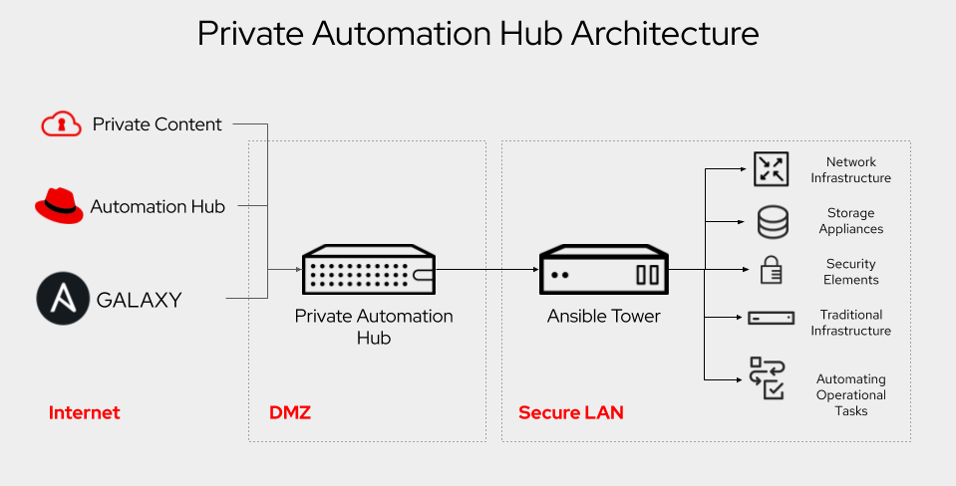
Galaxy NG/ automation hub
Using a private automation hub provides
  An internal access to Galaxy roles / collections
  An internal access to home made roles / collections
  Access control to roles / collections
  An approbation life cycle
capture historique (schéma d'architecture)

Slide 210
slow tasks + callback
Configure ansible.cfg with the plugins:
[defaults]
inventory = ./hosts
callbacks_enabled = timer, profile_tasks, profile_roles
$ ansible-playbook site.yml
PLAY [Deploying Web Server] ************
TASK [Gathering Facts] **********************
Thursday 23 December 2021 22:55:58 +0800 (0:00:00.055) 0:00:00.055
Thursday 23 December 2021 22:55:58 +0800 (0:00:00.054) 0:00:00.054
ok: [node1] TASK [Deploy Web service] *******************
Thursday 23 December 2021 22:56:00 +0800 (0:00:01.603) 0:00:01.659
Thursday 23 December 2021 22:56:00 +0800 (0:00:01.603) 0:00:01.658
...<output removed>...
PLAY RECAP **********************************
node1: ok=9 changed=4 unreachable=0 failed=0 skipped=0 rescued=0 ignored=0
Playbook run took 0 days, 0 hours, 0 minutes, 14 seconds
Thursday 23 December 2021 22:56:12 +0800 (0:00:00.541) 0:00:14.100 *****
===============================================================================
deploy-web-server : Install httpd and firewalld ------- 5.42s
deploy-web-server : Git checkout ---------------------- 3.40s
Gathering Facts --------------------------------------- 1.60s
deploy-web-server : Enable and Run Firewalld ---------- 0.82s
deploy-web-server : firewalld permitt httpd service --- 0.72s
deploy-web-server : httpd enabled and running --------- 0.55s
deploy-web-server : Set Hostname on Site -------------- 0.54s
deploy-web-server : Delete content & directory -------- 0.52s
deploy-web-server : Create directory ------------------ 0.41s
Deploy Web service ------------------------------------ 0.04s
Thursday 23 December 2021 22:56:12 +0800 (0:00:00.541) 0:00:14.099
=====================================================================
deploy-web-server ------------------------- 12.40s
gather_facts ------------------------------- 1.60s I
nclude_role ------------------------------- 0.04s
~~~~~~~~~~~~~~~~~~~~~~~~~~~~~~~~~~~~~~~~~~~~~~~~~~
total ------------------------------------- 14.04s

Slide 211
Facts Gathering
Facts are gathered on top of ALL Playbook/Plays. It connects to Every servers and collects many information.
If none of these facts are required for the play, it is wise to disable it:
Configure Playbook with:
gather_facts: False
Running multiple plays:
activate the gather facts caching
gather_facts: true => only once per playbook
$ time ansible-playbook site.yml
PLAY [Deploying Web Server] *********************
TASK [Gathering Facts] **************************
ok: [node1]
...<output removed>...
PLAY RECAP **************************************
node1: ok=9 changed=4 unreachable=0 failed=0 skipped=0 rescued=0 ignored=0
ansible-playbook site.yml 30.03s user 0.93s system 25% cpu 15.526 total
$ time ansible-playbook site.yml
PLAY [Deploying Web Server] ****************
...<output removed>...
PLAY RECAP **************************************
node1: ok=8 changed=4 unreachable=0 failed=0 skipped=0 rescued=0 ignored=0
ansible-playbook site.yml 20.96s user 1.00s system 26% cpu 14.992 total

Slide 212
Connection
Ssh is time consuming while establishing
ControlMaster helps by using the same network connection for multiple session
ControlPersist makes an unused network connection opened for future uses
[ssh_connection]
ssh_args = -o ControlMaster=auto -o ControlPersist=60s
Pipelining = True
By default SSH check the SSH host keys to prevent spoofing or Man-in-the-middle, which consume time. It can be disabled
[defaults]
host_key_checking = False

Slide 213
Strategy
By default, Ansible use linear strategy : runs tasks on all servers and wait for the tasks to finish on all servers before running the next task.
This is that, the delay of the task is the time of the slowest executed task.
When all the tasks have no relation between all servers, they can be run independently with the strategy free
Host A
Task 1
Task 2
Task 3
Host B
Task 1
Task 2
Task 3
Host C
Task 1
Task 2
Task 3
Host A
Task 1
Task 2
Task 3
Host B
Task 1
Task 2
Task 3
Host C
Task 1
Task 2
Task 3

Slide 214
Parallelism
Split the server list in multiple batches:
By default, each tasks are split in batch of 5; wait for the batch to complete and then run the task again with the next batch.
Increase the FORK value to reduce the waiting time
Strategy: Linear
Fork: 3
Host: A
Task 1
Task 2
Task 3
D
Task 1
Task 2
Task 3
Host: B
Task 1
Task 2
Task 3
E
Task 3
Task 1
Task 2
Host: C
Task 1
Task 2
Task 3
F
Task 1
Task 2
Task 3
Strategy: Free
Fork: 3
Host: A
Task 1
Task 2
Task 3
D
Task 1
Task 2
Task 3
Host: B
Task 1
Task 2
Task 3
E
Task 1
Task 2
Task 3
Host: C
Task 1
Task 2
Task 3
F
Task 1
Task 2
Task 3
Strategy: Free
Fork: 6
Host A
Task 1
Task 2
Task 3
Host B
Task 1
Task 2
Task 3
Host C
Task 1
Task 2
Task 3
Host D
Task 1
Task 2
Task 3
Host E
Task 1
Task 2
Task 3
Host F
Task 1
Task 2
Task 3

Slide 215
Asynchroneous
A long duration task can be not blocking as other task can be run in parallel:
tasks:
- name: Initiate custom snapshot take long time
shell: "/opt/diskutils/snapshot.sh init"
async: 120 # Maximum allowed time in Seconds
poll: 05 # Polling Interval in Seconds
register: snapshot_job_id
- name: other task
….
- name: other task
….
- name: Check on an async task
async_status: jid: "{{snapshot_job_id}}"
register: job_result
until: job_result.finished
retries: 100 # Max checks
delay: 10 # Waits 10 seconds between checks
Task 1
Task 2
Task 3
Task 1
Task 1
Task 2
Task 3
check
check

Slide 216
Tasks
Avoid repetitive tasks or loops when the native multivalue module feature is available
- name: install the latest version of nginx
yum:
name: nginx
state: latest
- name: install the latest version of postgresql
yum:
name: postgresql
state: latest
- name: install the latest version of postgresql-server
yum:
name: postgresql-server
state: latest
- name: install the latest versions
yum:
name: '{{ item }}"
state: latest
loop:
- nginx
- postgresql
- postgresql-server
- name: install the latest versions
yum:
name:
- nginx
- postgresql
- postgresql-server
state: latest
Avoid using shell or command tasks, always check if native module exists

Slide 217
Role guidelines:
- tools should be as a Role
- VM references should be taken from the hostvars inventory
- the role must be used from PROVISIONING as well as RETIREMENT
- to avoid fact naming conflicts:
- internal role vars should be like _<role_name>_<var_name>
- internal role vars MUST be declared in the defaul/main.yml and initialized from external role vars:
_myRole_var1: myRole_var1|default("default_var")
- don't reference environment variables
- no secrets in the role
- It should be convenient to Implement a CRUD (Create, Read, Update, Delete)
- a Sanity.yml may be called at starting to do some checks and validation of the extra vars and context
- the main.yml will check and call the corresponding task file
- groups are defined as one group per Solution, Environement and Function, as well as a group for each tags
- miq tags are availlable in miq_tags:{<classification name>:{'name': <tag name>, 'descritpion':<tag descritpion>}}
- miq_action provides wether provisionning, retirering, reconfigurering
- playbooks/roles are run from awx.example.com via "-J" option
- name: delegate action
vars:
ansible_ssh_user: 'root'
ansible_ssh_common_args: ''
delegate_to: awx.example.com
shell: xxxxx
MyRole/
vars/
default.yml
tasks/
sanity.yml
main.yml
Create.yml
Read.yml
Update.yml
Delete.yml

Slide 218
Cas concret
Automation Integration Rules
Notes:
The real work. General format:
<<module>>: key=value
218

Slide 219
Playbooks
  Don’t use VM in host lists, use group intersection
    Vms are grouped by solution/environment/function
    Hosts: "<solution>:&<environment>:&<function>"
  Don't reference environment variables
  miq_action provides whether provisionning, retiring, reconfigurering
  miq tags are available in
    miq_tags:{<classification name>:{'name': <tag name>, description':<tag description>}}

Slide 220
# My Playbook: Network Tester
================================
## Overview
This playbook tests network connectivity between two servers using a custom module.
## Requirements
* ansible-core 2.20 or later
* Python 3.12 or later (control node)
* The `network_tester` custom module (included in this repository)
## Role Variables
The following variables are required:
* `src_server`: The source server IP or hostname
* `dst_server`: The destination server IP or hostname
* `protocol`: The network protocol to use (TCP, UDP, etc.) (default: TCP)
Optional variables:
* `connection_message`: The connection message to send (default: "Hello, world!")
## Example Usage

Slide 221
Roles
  tools should be as a Role
  Meta information set for documentation
galaxy_info:
author: Your Name
description: A brief description of the role
company: Your Company (optional)
license: license (e.g. GPLv3, MIT, etc.)
min_ansible_version: "2.20"
platforms:
- name: EL
versions:
- "9"
- name: Ubuntu
versions:
- jammy
- noble
- name: Debian
versions:
- bookworm
galaxy_tags:
- network
- security
- testing
role_vars:
- src_server:
description: The source server IP or hostname
required: true
- dst_server:
description: The destination server IP or hostname
required: true
- protocol:
description: The network protocol to use (TCP, UDP, etc.)
required: true
default: TCP
- connection_message:
description: The connection message to send
required: false
default: "Hello, world!"
dependencies: []

Slide 222
One for All
  no secrets in the role/playbooks => VAULT
  fact naming conflicts:
    internal role vars should be like _<role_name>_<var_name>
    internal role vars MUST be declared in the default/main.yml and initialized from external role vars:
      _myRole_var1: myRole_var1|default("default_var")
  Sanity.yml:
    do some checks, assertion and validation of the extra vars and context
    Use a dedicated fact to assert/validate role execution (<role>_execution: [true/false])
  the main.yml must call
    Sanity check files
    the corresponding task files

Slide 223
  It should be convenient to Implement a CRUD (Create, Read, Update, Delete)
    MyRole/
      vars/
        default.yml
      tasks/
        sanity.yml
        main.yml
        Create.yml
        Read.yml
        Update.yml
        Delete.yml
  Set well descriptive name for all tasks and plays
  Avoid useless tasks, use conditions (when)
  Use the handlers to avoid multiple runs of a single tache

